Slide 1
Narratives
Stage 1 - Term 4
Week 1

Slide 2
Table of contents
01
02
03
Tuesday
Wednesday
Click here to take you to Tuesday’s work!
Click here to take you to Wednesday’s work!
Thursday/Friday
Click here to take you to Friday’s work!

Slide 3
01
Tuesday
What are narratives?

Slide 4
What is a Narrative?
Narrative texts tell a story to entertain the reader. They have:
There are many types of narrative texts, such as picture books, short stories and fairy tales.
a setting | a time and place
characters | people, animals or objects
a series of events | events that happen to your character
a problem with a resolution | the character needs to resolve the problem at the end of the story

Slide 5
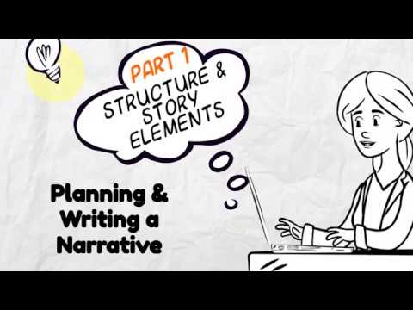
Watch the video to learn how to write a narrative!

Slide 6
Your Turn!
Who is your main character?
Where does your story take place?
What will happen in the story?
How will your story end?

Slide 7
Planning your narrative
If you would like to print out a copy of the story mountain plan click here!
Or you can type your ideas right into the next slide.

Slide 8
Type your problem here...
Type your resolution here...
Type an event here...
Type here...
Type the end here...
Type the setting here...
Type your characters here...
Type the problem here...

Slide 9
02
Wednesday
Planning the Orientation

Slide 10
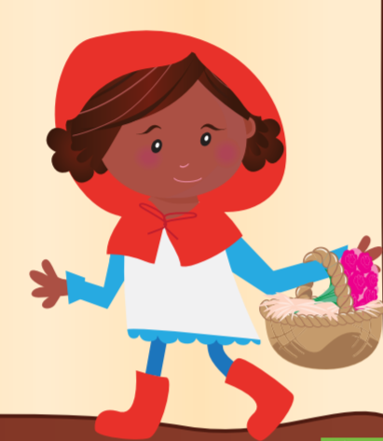
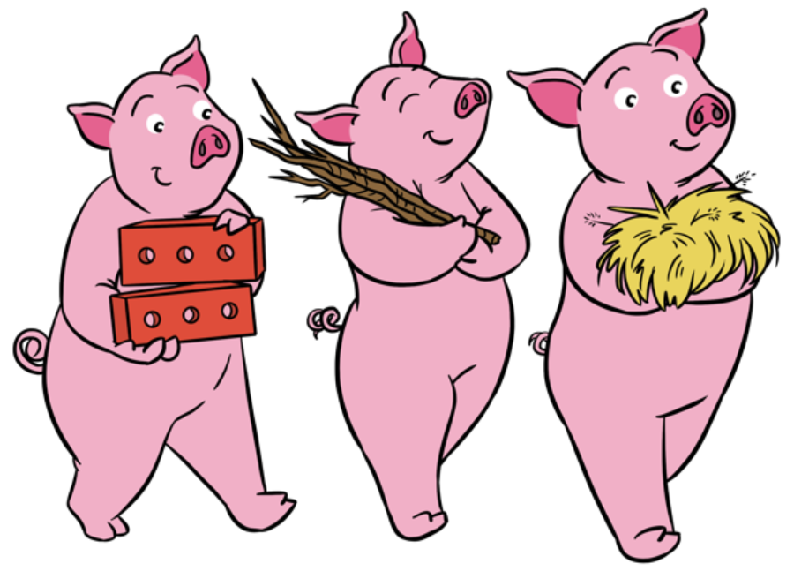
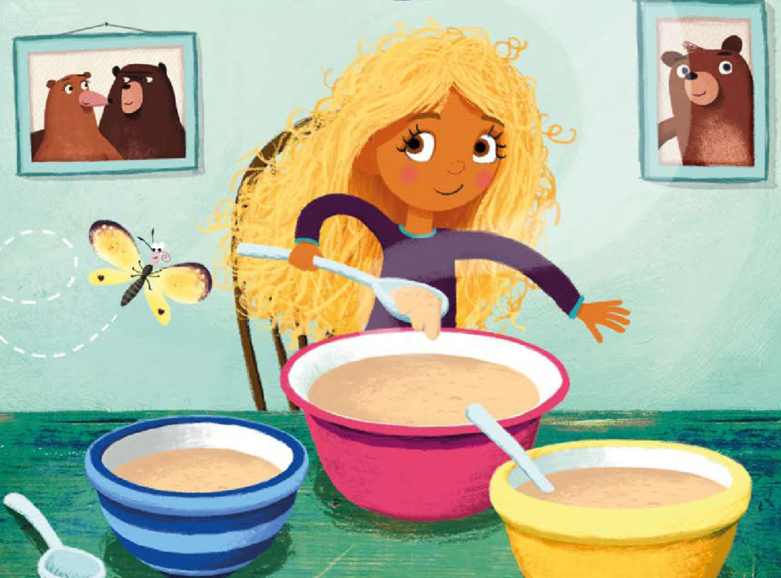
Examples of Characters
Do you know these characters? How would you describe them?

Slide 11
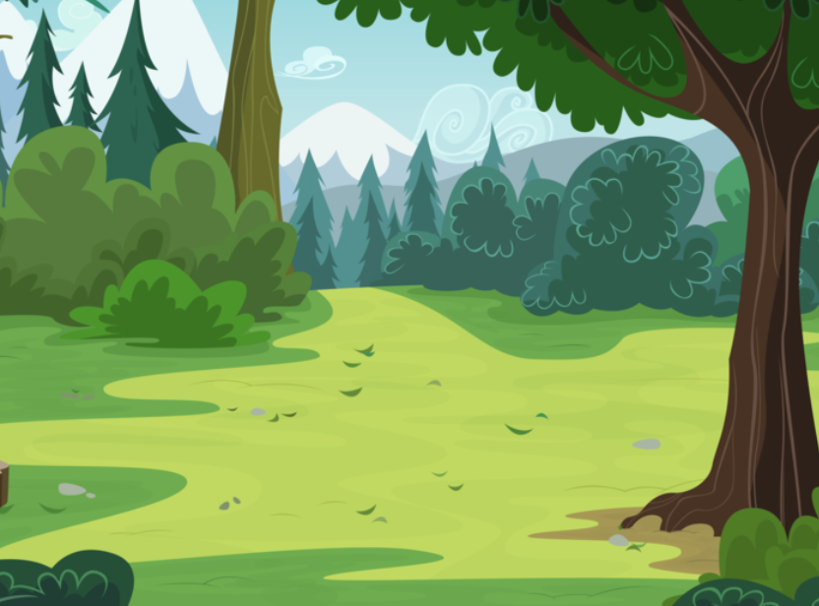
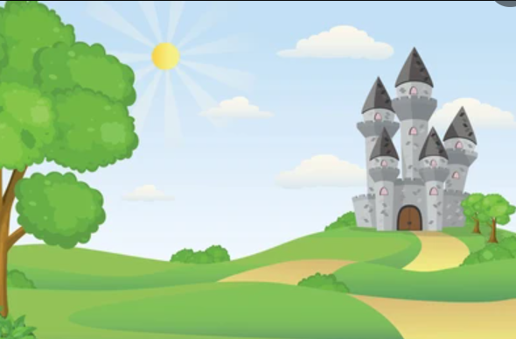
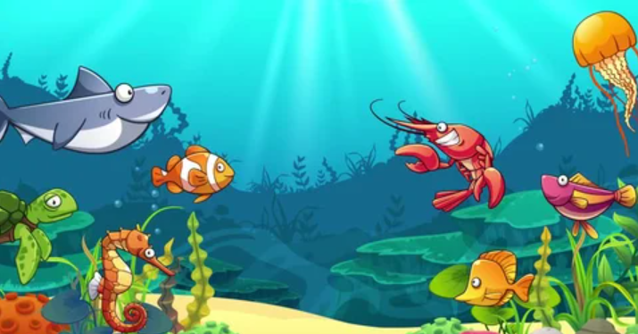
Examples of Setting
Where will you set your story? How would you describe the setting?

Slide 12
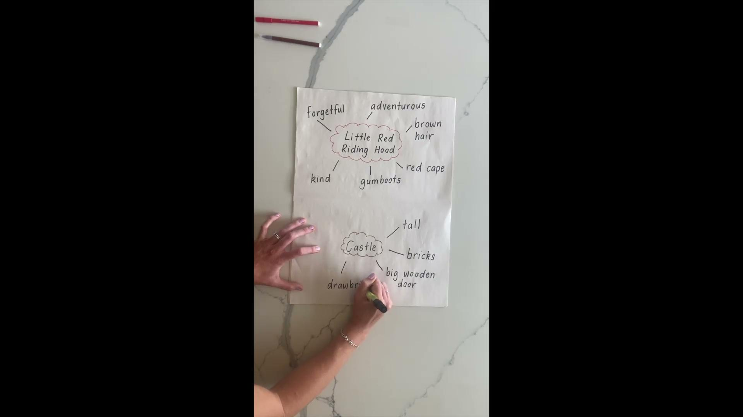
Planning your characters and the setting
We are going to brainstorm some adjectives (describing words) about our character and the setting of our story. Watch Mrs Easton’s video below.

Slide 13
Your Turn!
You are going to create a character and a setting for our narrative - Keep this Character Plan with your Story Mountain Plan. You can write in in your workbook or on the next slide.
Who is your main character?
Think of some describing words!
Where does your story take place?
In a forest? In space? In your backyard?

Slide 14
The Characters and the Setting
Type some adjectives to describe your character here...
Type some adjectives to describe the setting for your narrative story here...

Slide 15
03
Thursday/Friday
Writing the Orientation

Slide 16
Writing your orientation
In our orientation, we set the scene for our story. We need to include the characters and describe the setting. Watch the video for an example by Mrs McCrindle.

Slide 17
Your Turn!
Have a go at writing your orientation now.
You can write in in your workbook or on the next slide.
It only has to be a couple of sentences, but you can write more if you like!
Describe your character using interesting adjectives from your brainstorm.
Describe the setting - what can your character see and hear?
Set them off on their journey!

Slide 18
The Orientation
Type your orientation here…

Slide 19
Wow!
You have completed the orientation for your narrative. Keep it handy - don’t throw it out! We are going to finish the story next week.

