Slide 1
Pobble Writing T4 Wk 1
The Glass House https://www.pobble365.com/

Slide 2
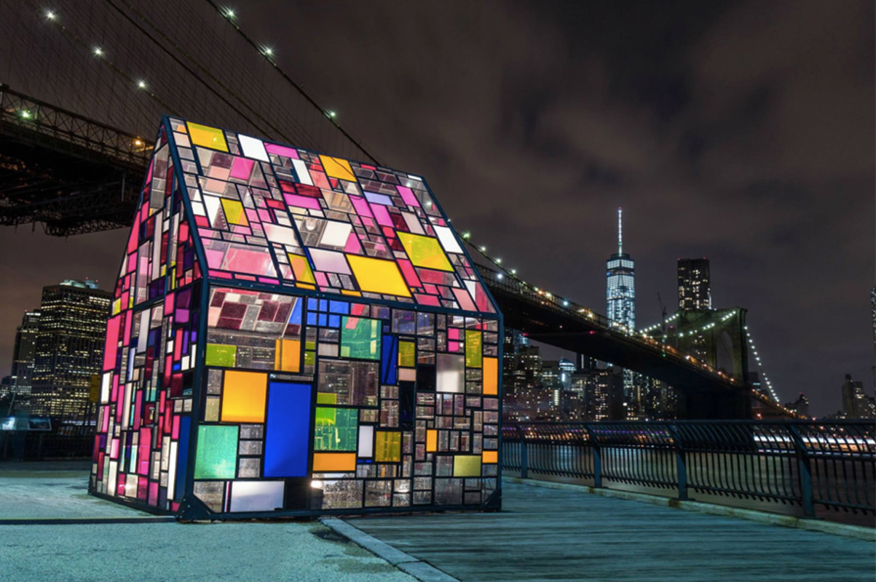
Take a good look at this weeks image: The Glass House

Slide 3
Read the STORY STARTER BELOW about the photograph:
Silently, Sarah pressed the switch and took a deep breath. Colours filled the house as beams of light hit the coloured panes of glass. It was just as she has hoped for, just as she had imagined. Carefully, she turned a full circle to take in the rainbow world she had designed and created. She knew it was going to become a special place for the people of this enormous city.
Clarifying some words in the text...
beams: to emit beams, as of light.
panes: one of the divisions of a window, like a single plate of glass in a frame.
imagined: to think, believe, or fancy:
enormous: greatly exceeding the common size (huge, immense, gigantic)

Slide 4
QUESTION TIME:
Read each question carefully, there is space for you to answer each question underneath.
HINT:Try and write using full sentences and use conjunctions where possible to extend your answers.
Q1) Why has the house been built there? Who will be using it?
A)
Q2) Why do you think Sarah chose that location for her rainbow glass house to be made?
A)

Slide 5
QUESTIONS CONTINUED..
Q3) What do you think Sarah’s job is? Is this the only building she has designed?
A)
Q4) If you were to create your own glass house, where would you build it and how would you like it to be used?
A)

Slide 6
Grammar/punctuation challenge
Beginning a sentence with an adverb gives your reader a real sense of how the action is taking place in your story.
For example:
Surprisingly, the lights took on a life of their own, creating a party of light in every direction.
Write your own sentences about the house, beginning with an adverb.
Record your example below:

Slide 7
Sentence Challenge
These sentences are ‘sick’ and need help to get better. Please help!!
The lights were on in the glass house. It was beside the bridge. It was small.
Can you think of a way to improve these sentences? Type your answers below:
Extension: (Optional)
Can you imagine what is inside the glass house?
Draw some items of furniture you might expect to find there or on a plan of the house.
Photo courtesy of Tom Fruin.
www.onebigphoto.com

