Slide 1
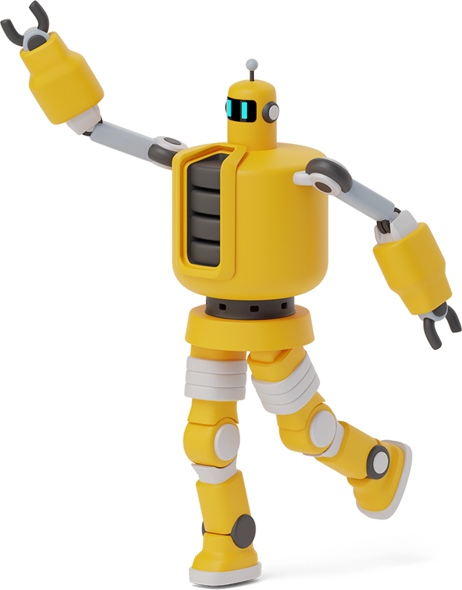
Stage 1 descriptive Writing
Week 10
Click on the day of the week to view the lesson
Monday
Wednesday
Thursday

Slide 2
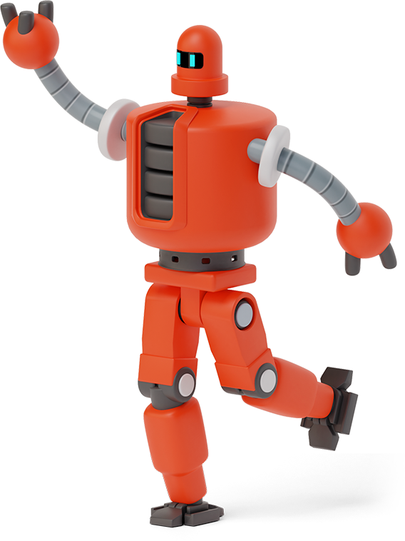
Monday
Monday
Descriptive Writing - Planning

Slide 3
Descriptive Writing
Click on the link ‘Light’ to view the short story animation. Think about Charlie’s robot helper.
Can you design and describe your own robot helper?
Do they have any special features or tools?

Slide 4
Descriptive Writing Plan
Watch the Modelled writing video on how to plan your writing. Using a blank piece of paper, plan your ideas for your robot character. Use keywords or phrases only.
Can you think of a name for your robot helper? Try to use similes, adjectives, verbs and adverbs to describe your robot helper.
Include ideas about:
Characters appearance
Special features / tools

Slide 5
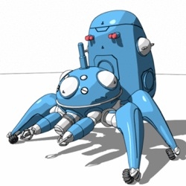
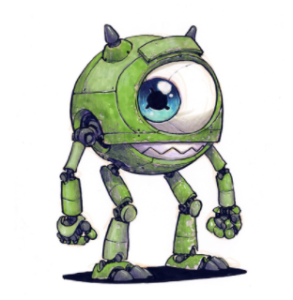
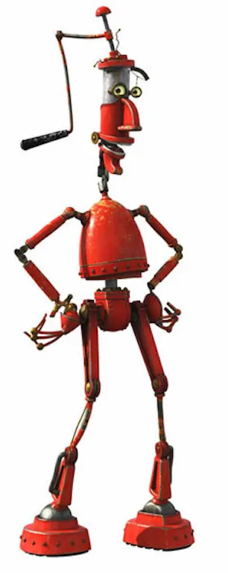
robot helpers
You may like to look at the following examples to get some ideas for the appearance or special features of your robot.

Slide 6
wednesday
Wednesday
Composing, Editing and Revising

Slide 7
Grammar checklist
You should use the following grammar checklist in your writing:
Similes
Adjectives
Verbs
Adverbs

Slide 8
Writing - Composing
Watch the Modelled Writing video on how to compose your description of your robot helper. Write a description about your robot helper. Make sure you describe their appearance and their special features or tools. Try to include similes, adjectives, verbs and adverbs.

Slide 9
Writing - Revising and editing
Once you have written your description you will need to edit your writing in a red pencil. Revise your writing with a green pencil. Do this by checking if you can add any extra information into your description to make it more interesting!

Slide 10
Thursday
Thursday
Publishing

Slide 11
Publishing
Publish your work in one of the following ways:
Write it in your best handwriting and draw a picture of your robot. Make sure your picture matches your writing.
Type up your piece of writing and then add your matching picture before uploading it to google classroom.
The Stage 1 teachers can’t wait to see what you present!

Slide 12
Optional - Extension Activity
Make a model of your Robot. You might like to use:
LEGO
PlayDoh
Modelling clay
Items that you would usually recycle
Craft items you have at home

