Slide 1
10
10:
https://www.youtube.com/watch?v=4liJs2sbi88

Slide 2
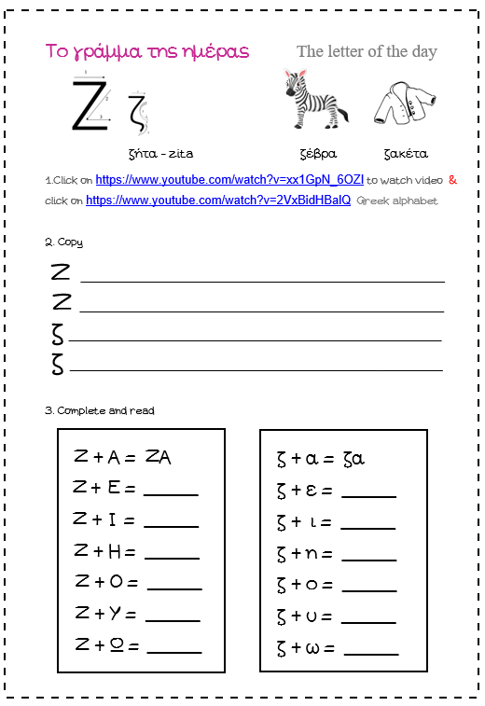

Slide 4
Letter of the day bracelet or bookmark

