Slide 1
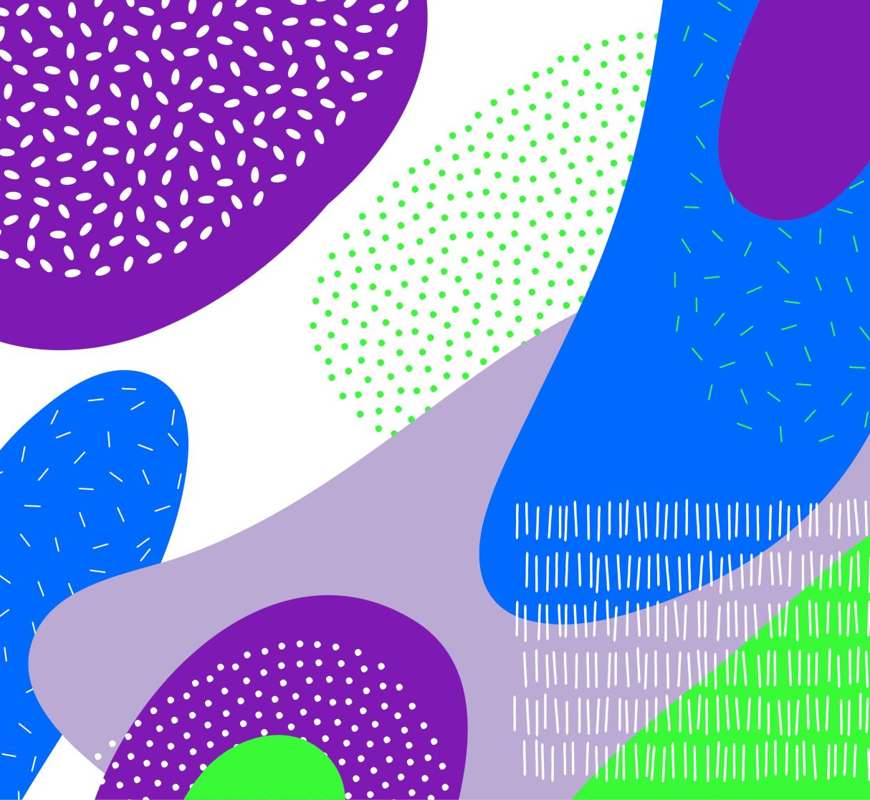
Term 4 Week 2
Art lesson with Mrs Hawkins
Egg Carton Faces or Recyclable Faces

Slide 2
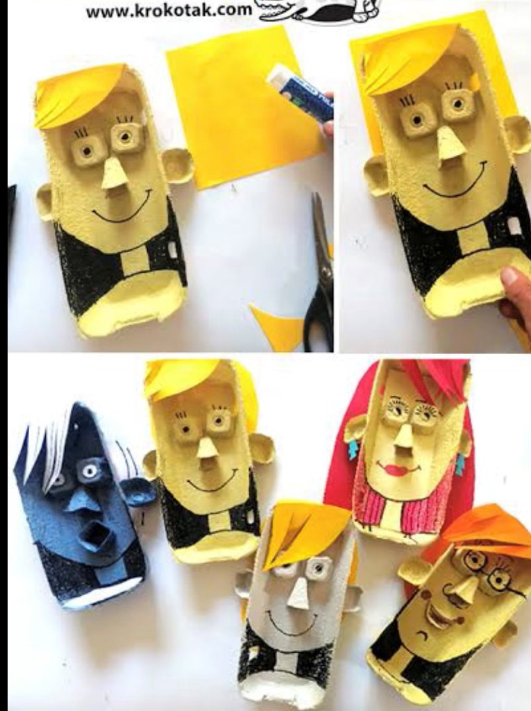
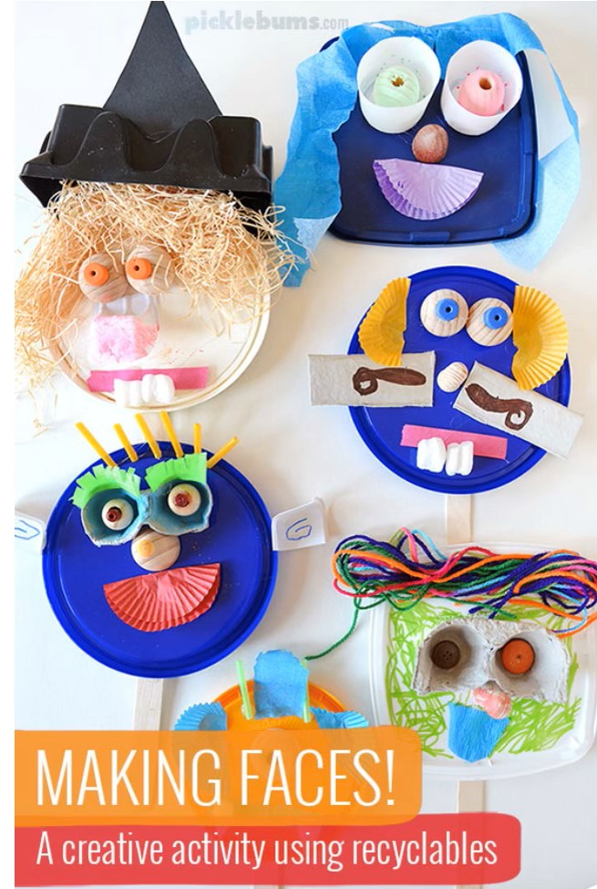
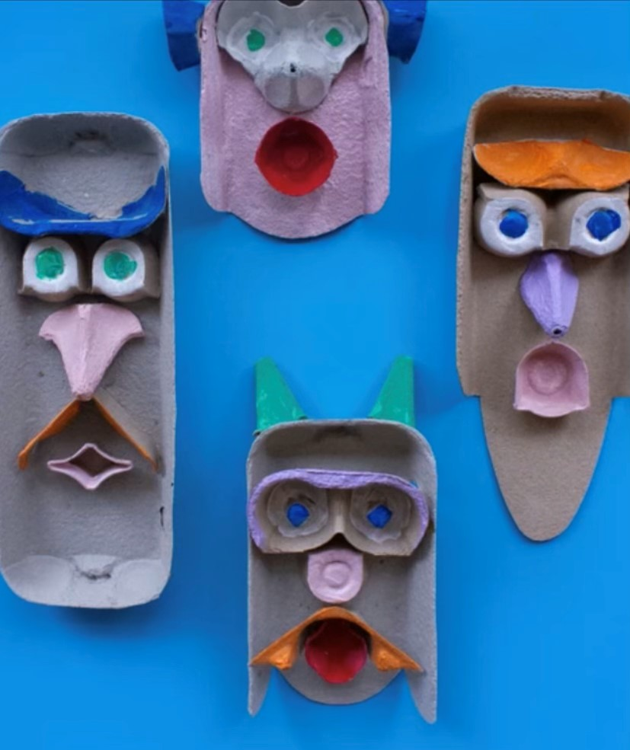
Egg Carton faces or Recyclable Faces!

Slide 3
Watch this video

Slide 4
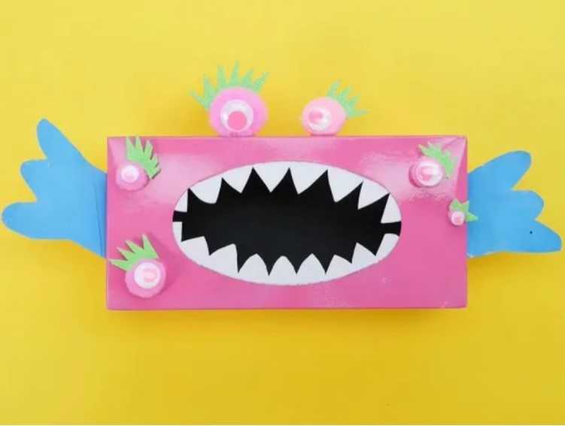
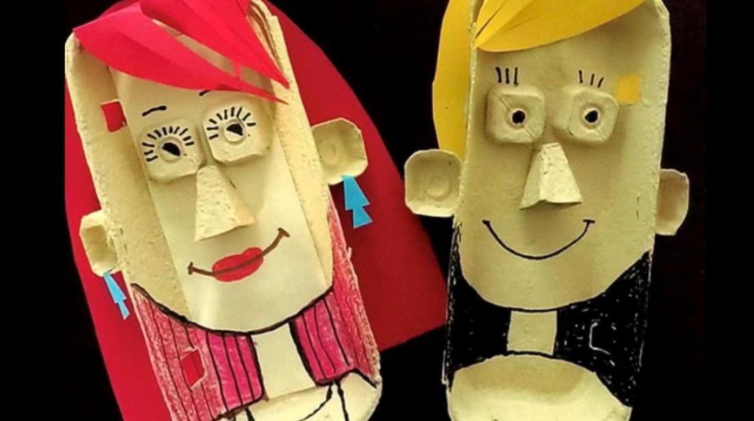
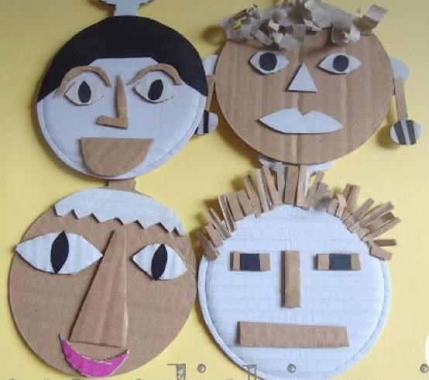
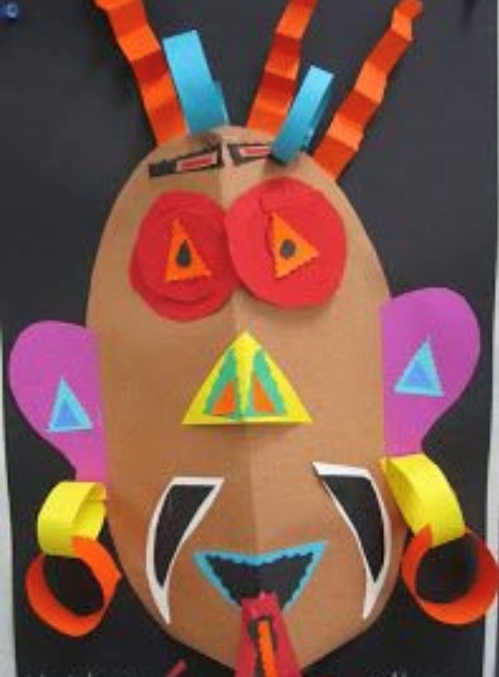
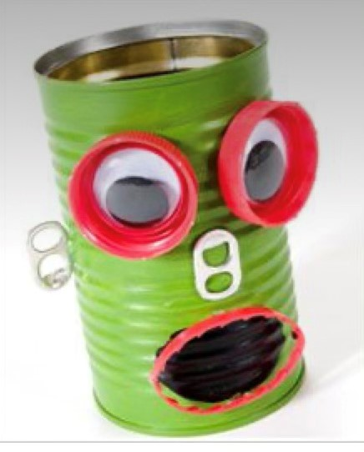
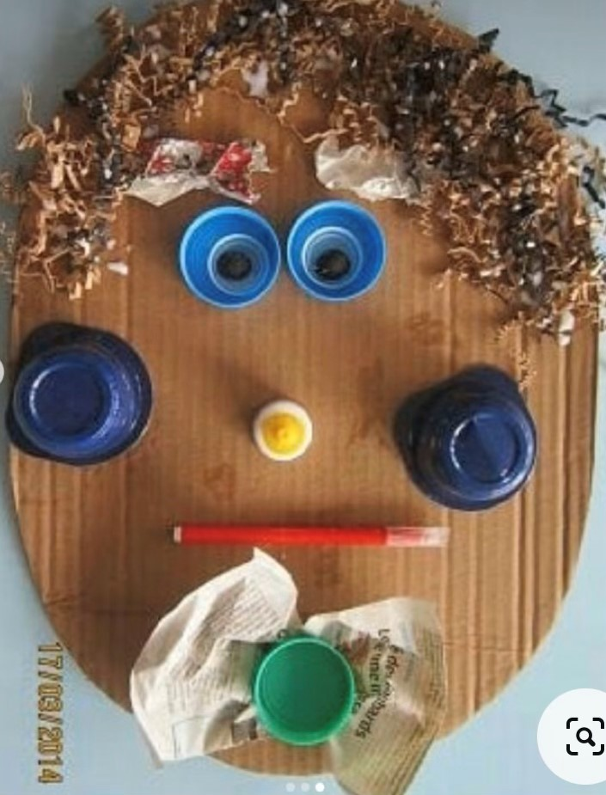
You don’t have to use an egg carton, you can use different recyclable materials such as a tissue box, cardboard box, plastic lids, ice cream container lids, bottle top lids for eyes and other bits and pieces.

Slide 5
Have fun creating your portrait face out of recyclable materials!!!
Make sure you take a photo of your masterpiece and post it in Google Classroom so I can see everyone’s amazing artwork!!
Thank you! I hope you enjoy making it!
Bye for now!
Press here to listen

