Slide 1
Narratives
Stage 1 - Term 4
Week 2

Slide 2
Table of contents
01
02
03
Monday
Wednesday
Click here to take you to Monday’s work!
Click here to take you to Wednesday’s work!
Thursday
Click here to take you to Thursday’s work!

Slide 3
01
Monday

Slide 4
Narratives - Week 2
You will need your story mountain map and your character brainstorm and setting brainstorm from last week.
Last week you completed your orientation - great work!!!
This week we will write the series of events, the problem and the resolution.

Slide 5
What is a Narrative?
Narrative texts tell a story to entertain the reader. They have:
There are many types of narrative texts, such as picture books, short stories and fairy tales.
a setting | a time and place
characters | people, animals or objects
a series of events | events that happen to your character
a problem with a resolution | the character needs to resolve the problem at the end of the story

Slide 6
Series of Events and Problem
Events are things that happen to the characters in the story. This includes a problem and the resolution.
Have a look back at your story mountain - we are going to add to our ideas.
Some events that could happen:
Your character meets some other characters
Your character loses something important
An evil villain tries to stop the character

Slide 7
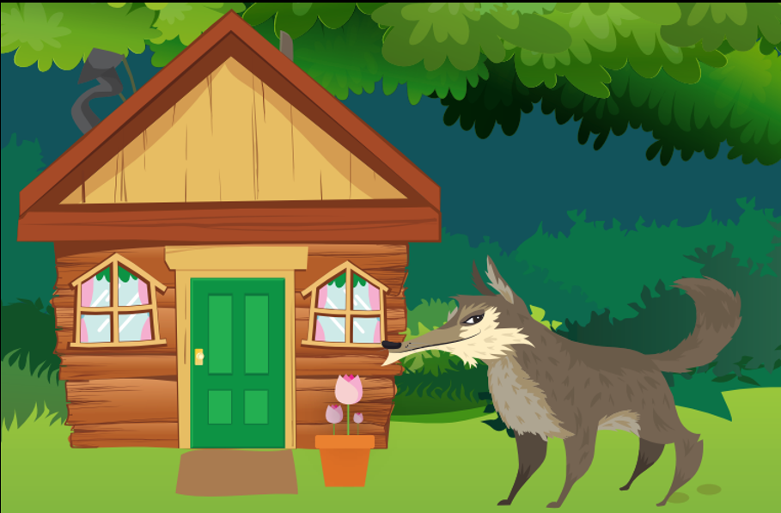
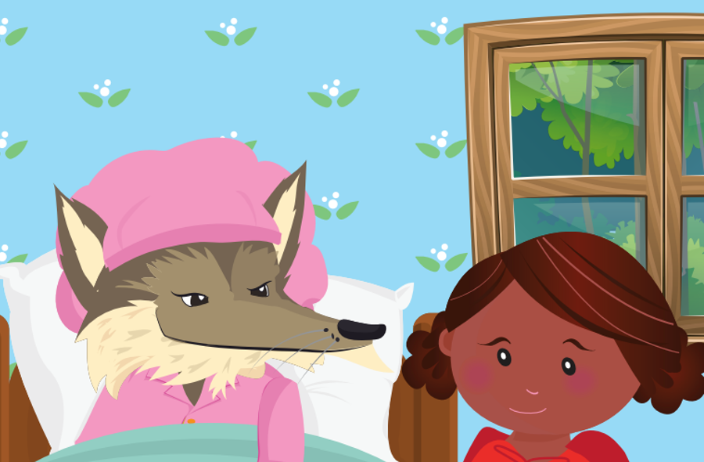
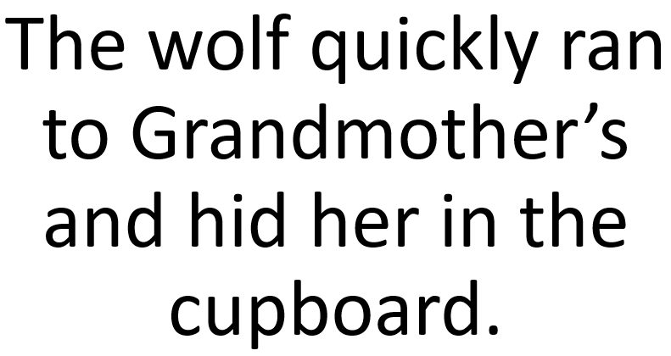
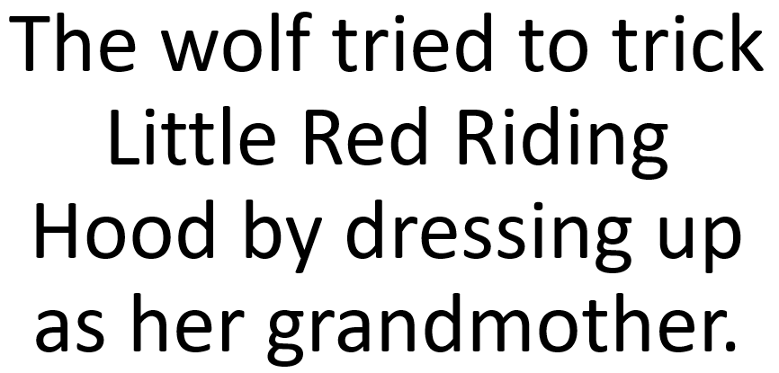
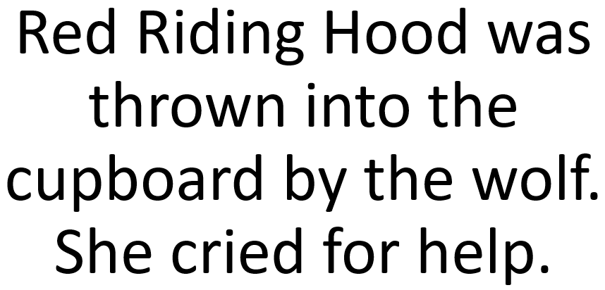
Series of Events - Little Red Riding Hood
These are some events that happened in the story of Little Red Riding Hood.

Slide 8
Your turn!
Watch Mrs Punzet model how to plan a series of events. Add your new ideas to your Story Mountain Map - on the original slide or on your printed copy.

Slide 9
Your turn!
If you can’t find your story mountain planner you can type your events here...

Slide 10
02
Wednesday

Slide 11
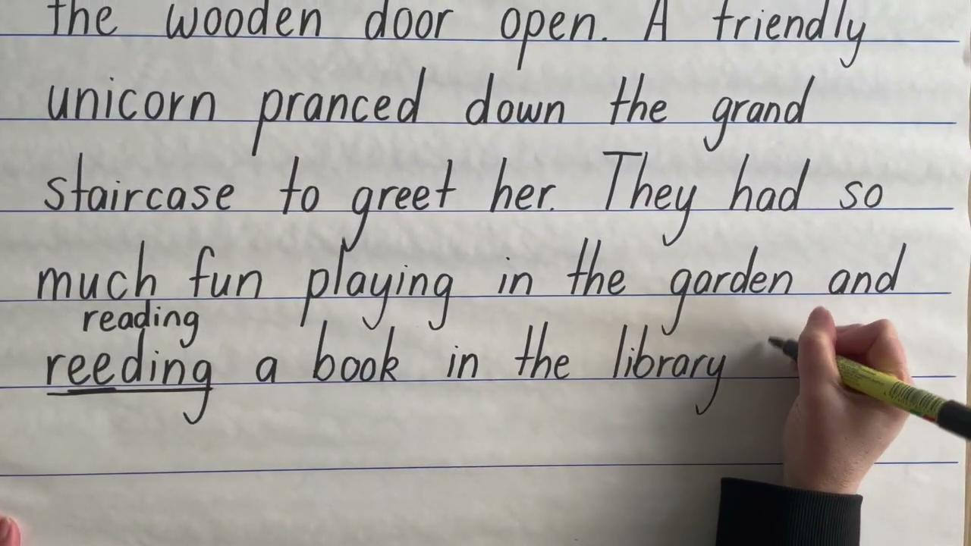
Series of Events and Problem
The middle part of the text is where there is a series of events and a complication (problem) in the story. Watch Mrs McCrindle’s example below, then it’s your turn! You can type on the next slide, or write in your workbook.

Slide 12
Your turn!
Type some events and the problem to your story here...

Slide 13
03
Thursday

Slide 14
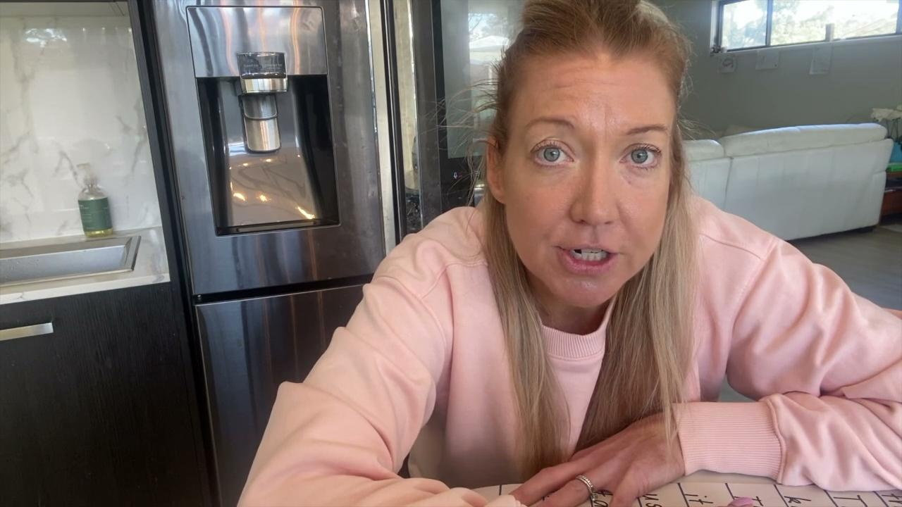
The Resolution
This is the ending of the story where the characters resolve the problem. Watch the example by Mrs Easton and then it’s you turn! Don’t forget to look back at your Story Mountain Plan to start. You can write it in your workbook or on the next slide.
Video of Resolution.
Teacher model using story mountain map

Slide 15
Your Turn!
Type your the resolution to your story here...

Slide 16
Wow!
You have completed a first draft of your narrative. Keep it handy - don’t throw it out! We are going to make it EVEN better next week.

Slide 17
Alternative resources

