Slide 1
Stage 1
Year 1
Week 2, Term 4
This is where you will find all of your maths number activities for this week.

Slide 2
Contents:
Click on the day of the week or the activity to view the lesson:
Tuesday:
Subtraction Number Talk
Split Strategy
Subtraction Tasks
Friday:
Number of the Day
5 Dice Game Activity

Slide 3
Tuesday

Slide 4
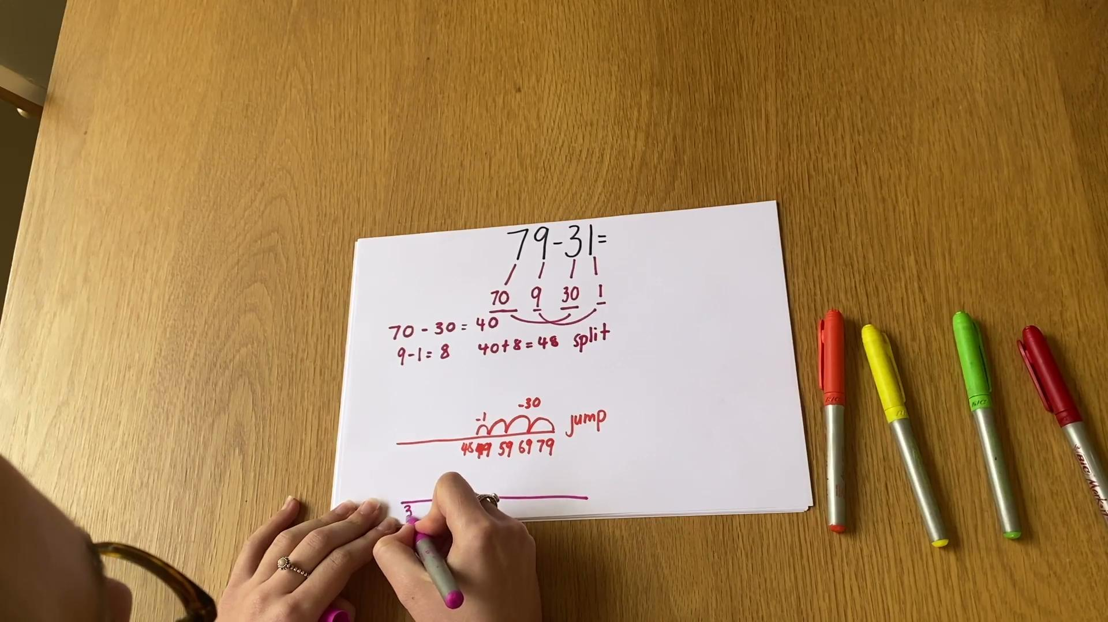
Number Talk:

Slide 5
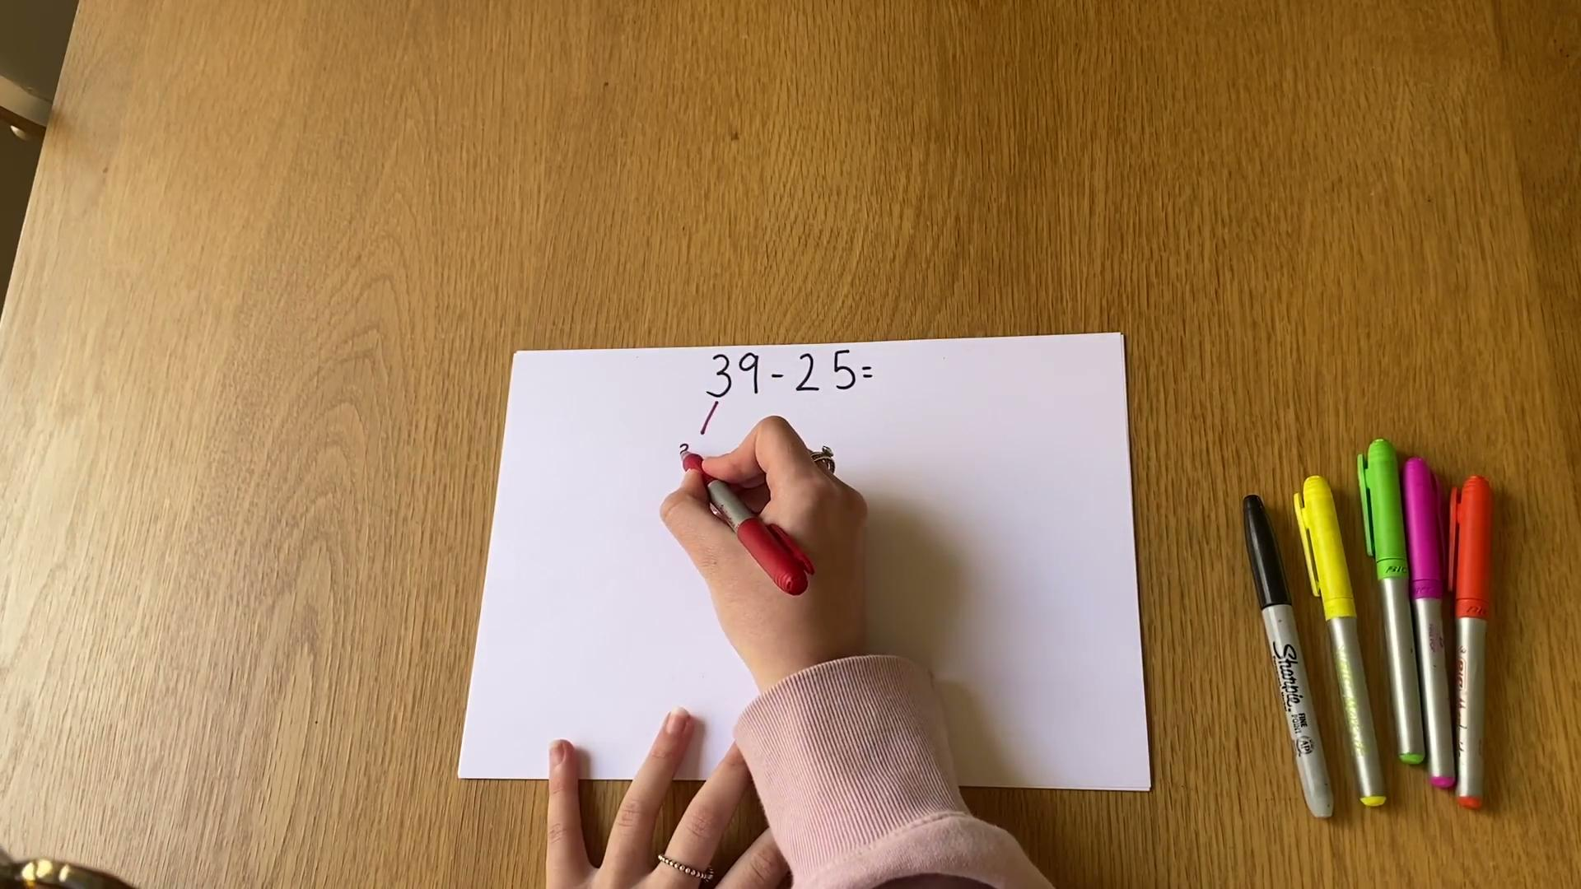
Split Strategy

Slide 6
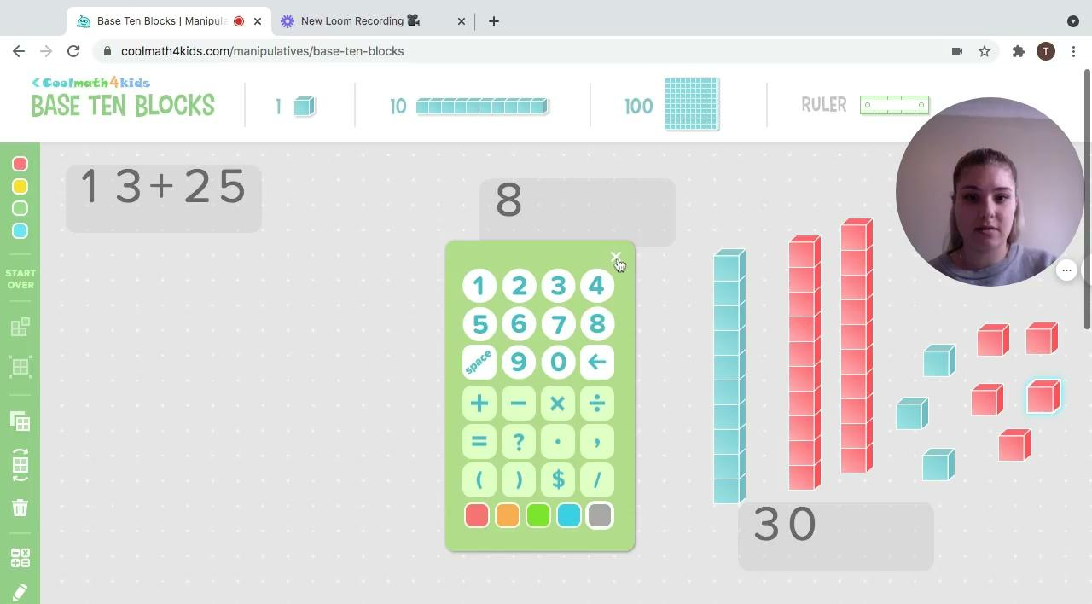
Using MAB blocks

Slide 7
Your Task...
You will need to use the split strategy to solve these problems. I would like to see you using your knowledge of place value and splitting your numbers into tens and ones. You can draw it on paper and insert an image on the next page or you could simply type directly onto the page.
Question 1:
42 + 17=
Question 3:
35 - 19 =
Question 2:
54 + 26 =
Question 4:
67 - 25 =

Slide 8
My Work
Post a picture of your work here!

Slide 9
Friday

Slide 10
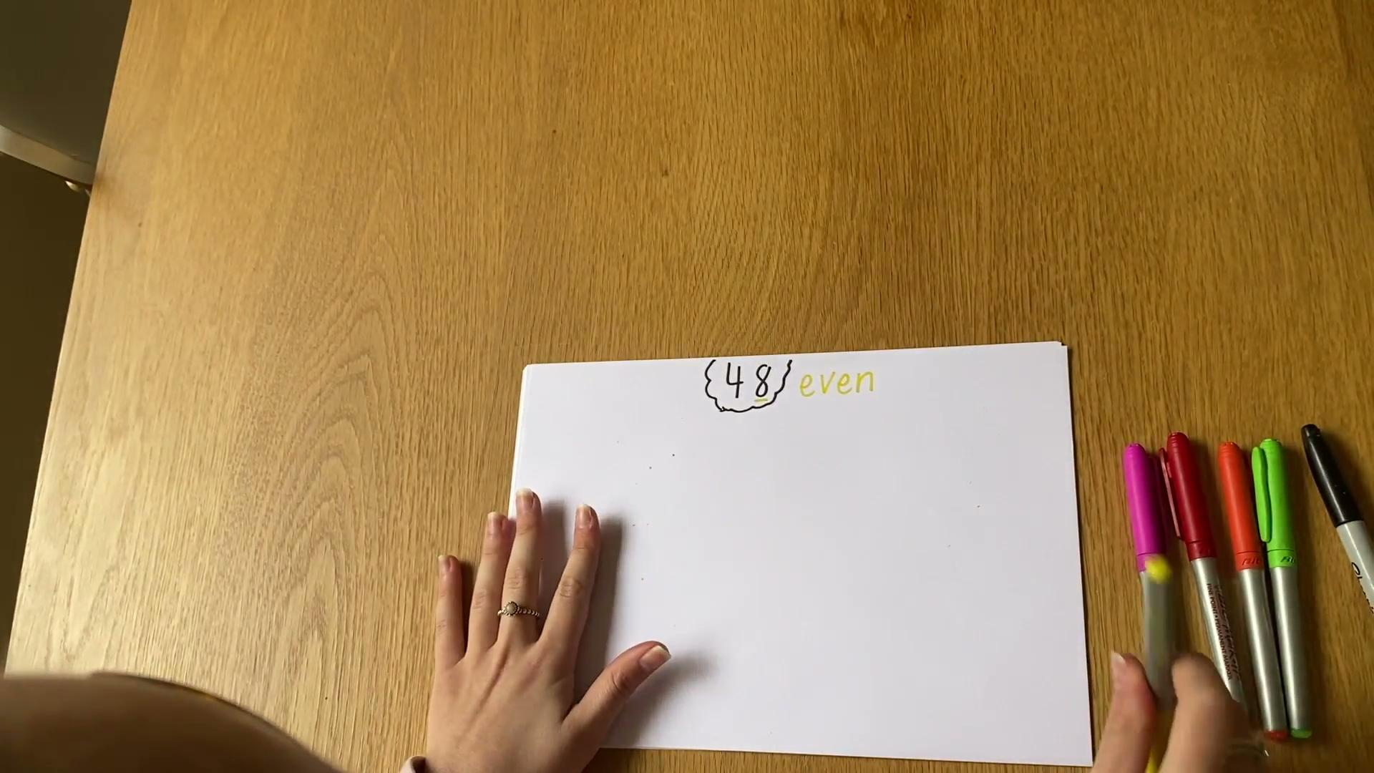
Number of the Day

Slide 11
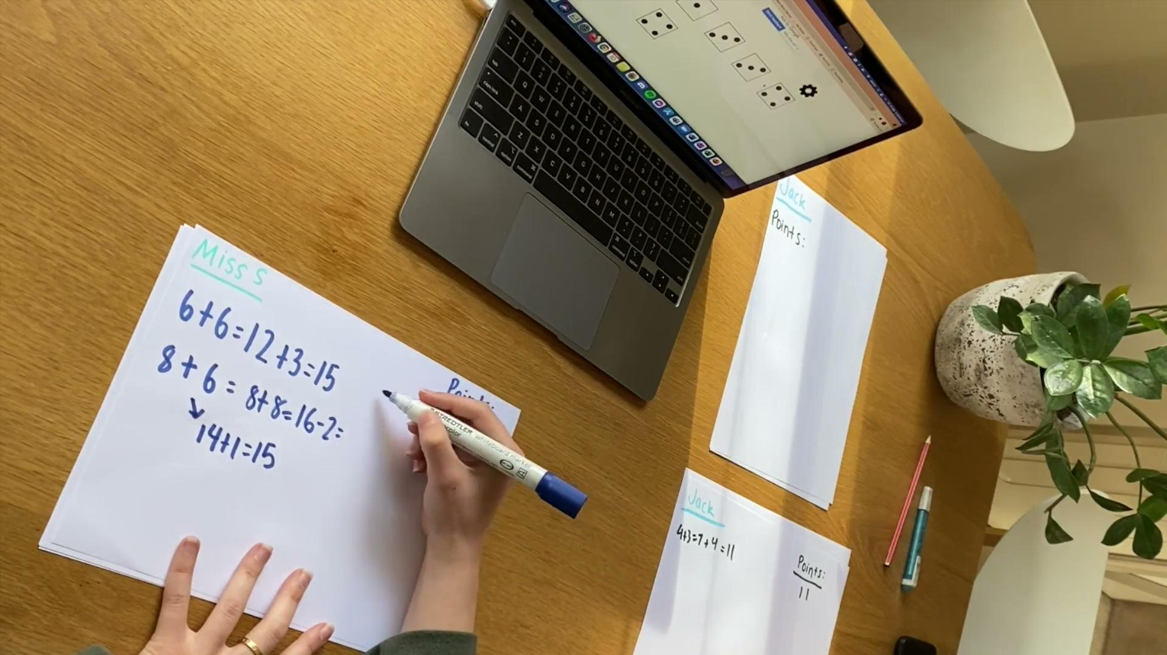
5 Dice Game Activity

Slide 12
My Work
Post a picture of your work here!

