Slide 1
Chance
Stage 1 Week 2, Term 4

Slide 2
Lesson oVERVIEW:
Find today’s work and click on the lesson link to be taken there directly.
Monday (Week 2) - Lesson 2: Certain, possible and impossible.
Thursday (Week 2) - Lesson 3: Even chance and 50/50 probability.

Slide 3
Lesson 2
Monday Week 2
Learning Intentions: I am learning about the types of events that have the probability of being certain, possible and impossible.

Slide 4
More chance terms
What do you think the following words mean? Discuss this with someone at home.
Certain
Possible
Impossible

Slide 5
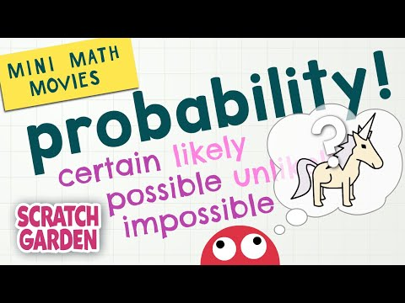
Mini Maths movie - Probability
There are lots of words we can use to talk about chance, or the likelihood of something happening. Watch the video to learn about some of them.

Slide 6
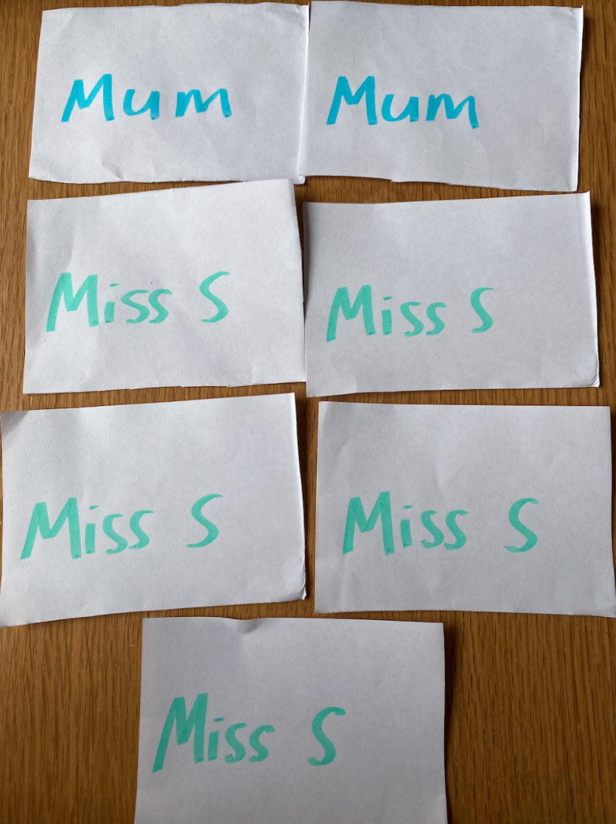
Activity 1
You will need 7 small pieces of paper. Write your name on 5 and another person’s on 2.

Slide 7
2. Put these pieces of paper into a container. What do you think will happen? Predict and type your answers below before you pull the pieces of paper out.
Predictions:
What are the chances of pulling your name out?
Type your answer here
What are the chances of pulling a rabbit out?
Type your answer here
Now pull a piece of paper out of the bag. Were you correct? Highlight your answer. Yes or no?

Slide 8
aCTIVITY 2
It is now your job to write an example of each event next to each term and provide a reason.
For example: Impossible - The chance of seeing a flying pig is impossible because pigs don’t have wings and they can’t fly.
Certain: Type your example and reason here
Possible: Type your example and reason here
Impossible: Type your example and reason here

Slide 9
Activity 3
Read the questions below and highlight the correct answer using the highlighter tool above or delete the unwanted answer.
It will rain on a cloudy day
Likely or unlikely?
Milk will go sour in a warm room
Likely or unlikely?
If you roll a 6 sided dot dice, you will roll a number between 7 and 12
Certain or impossible?
If you jump into a pond filled with water, you will get wet.
Certain or impossible?

Slide 10
Lesson 3
Thursday Week 2
Learning Intention:
I am learning what ‘even chance’ and ‘50/50 chance’ means.

Slide 11
What does 50/50 and even chance mean?
Discuss with someone at home what it might mean.
Do you know any events that have a 50/50 chance or even chance of happening?
Type your answer here.

Slide 12
Miss Shuetrim explains
Watch the video where Miss Shuetrim explains what the terms 50/50 and even chance mean. She will also speak about the possible outcomes of tossing a coin, which you need for the next activity!

Slide 13
What are the possible outcomes of tossing a coin?
Draw and label the possible outcomes of tossing a coin. Is one outcome more likely than the other?
Insert a picture of your work here and answer the question above.

Slide 14
Activity 1
You will need:
A coin or you can use this online coin toss because you are going to play a coin flipping game!
How to play:
You are going to play this game 2 times.
In both games you are going to flip the coin 20 times and record using tally marks if it lands on heads or tails.
Once you have completed the game and tossed your coins 20 times you are going to look at the results and write down any observations.
Watch Miss Shuetrim’s video on the next page to understand how to play!

Slide 15
How to play:

Slide 16
Answer the following questions about your results:
Are your results the same as before? Type your answer here
If your results changed, what is different and why do you think this is? Type your answer here
Post a picture of your work here

