Slide 1
Term 4 Week 3
Creating Art with Nature inspired by Andy Goldsworthy

Slide 2
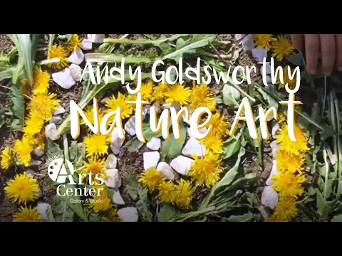
Watch this video:

Slide 3
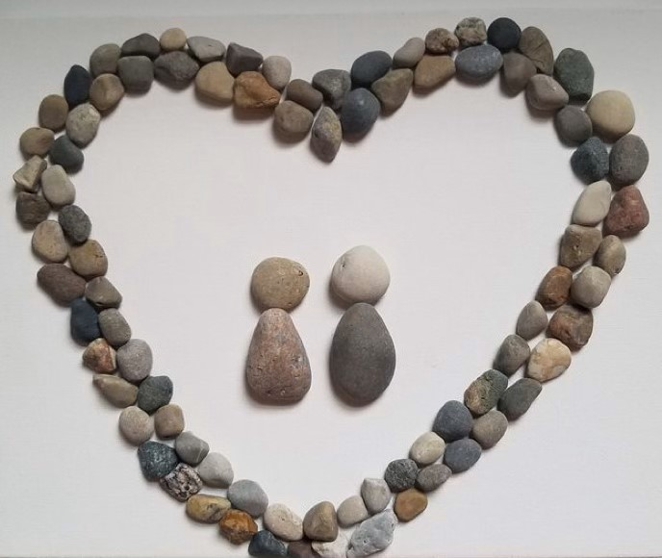
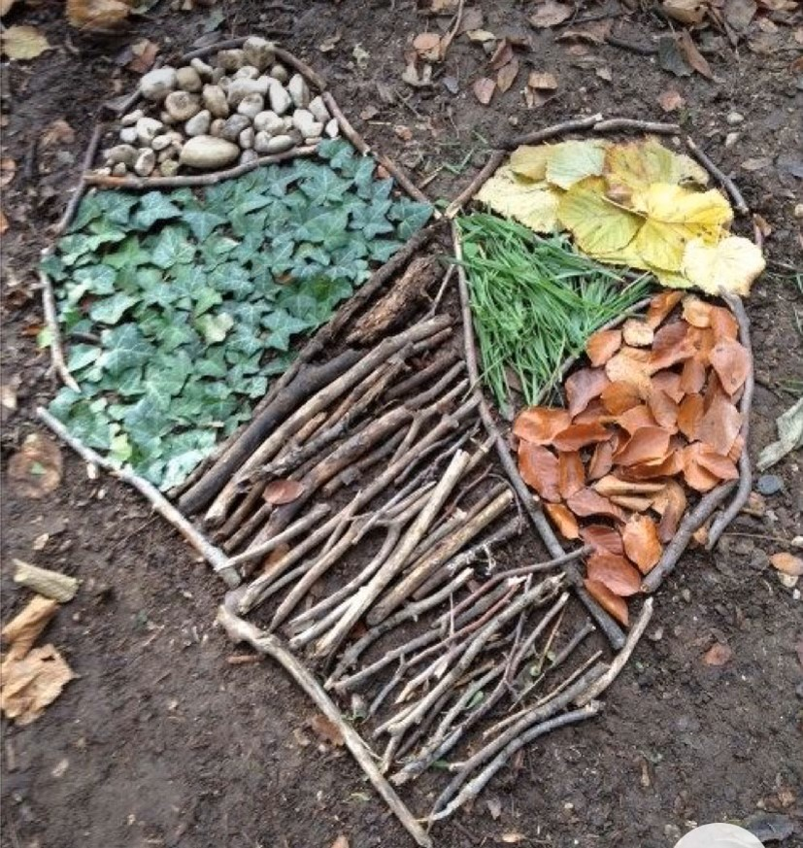
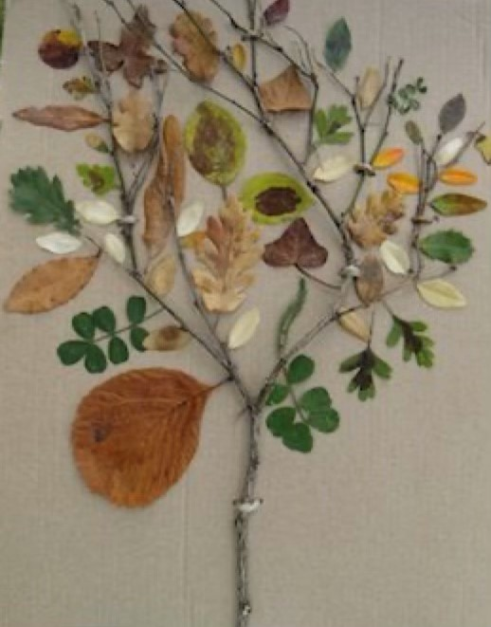
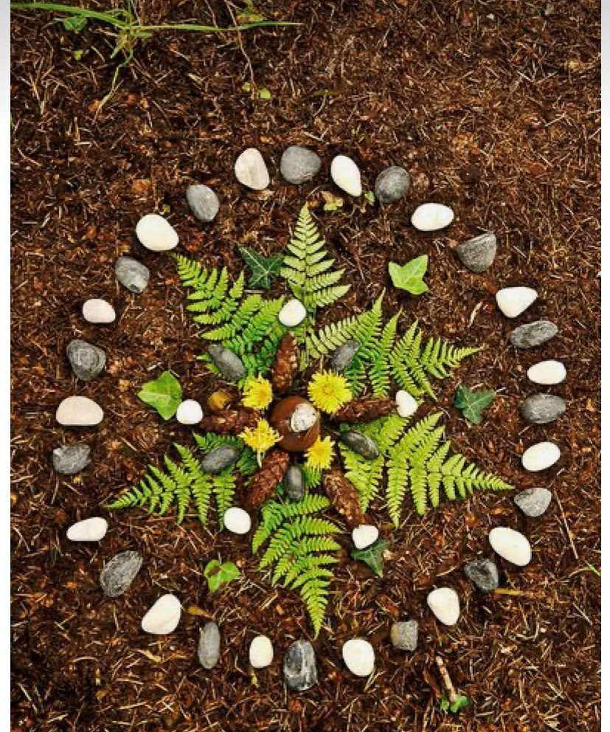
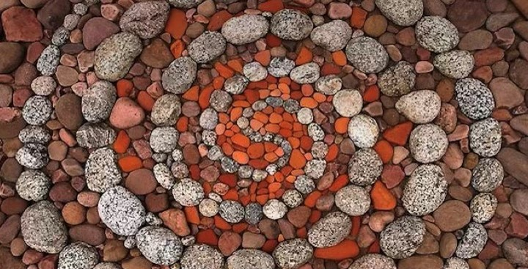
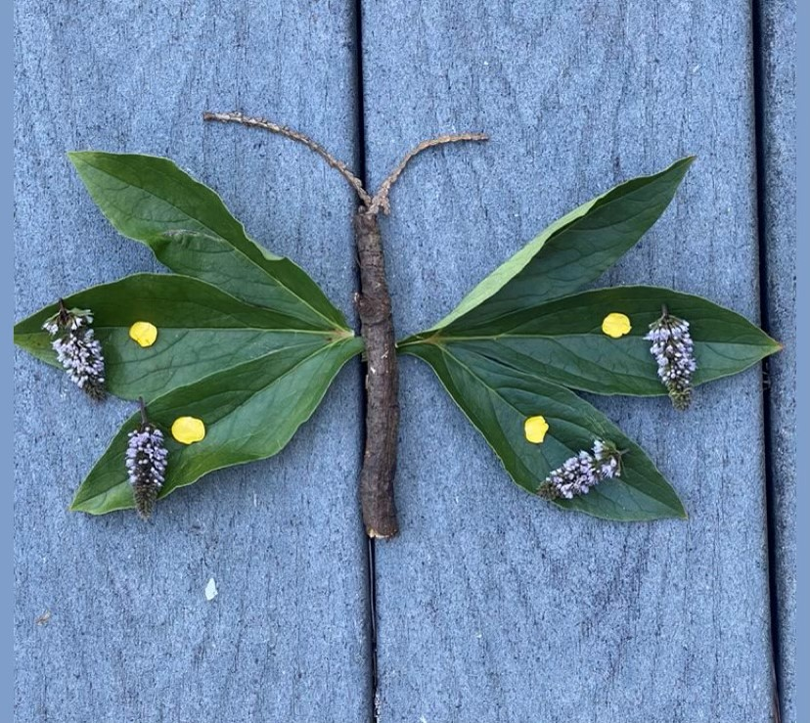
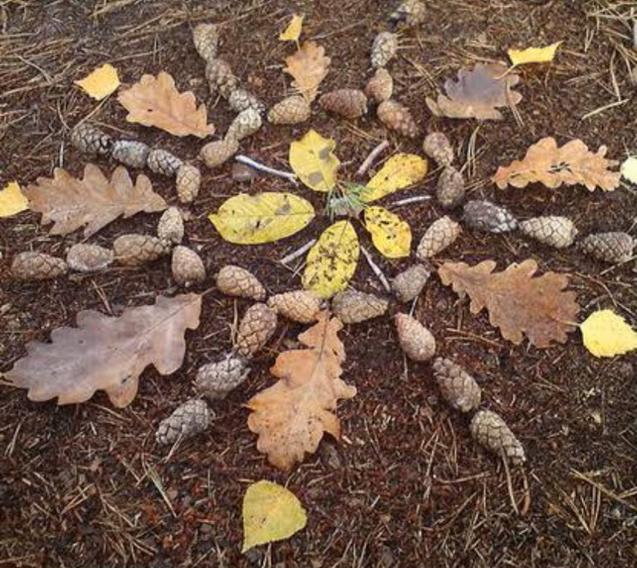
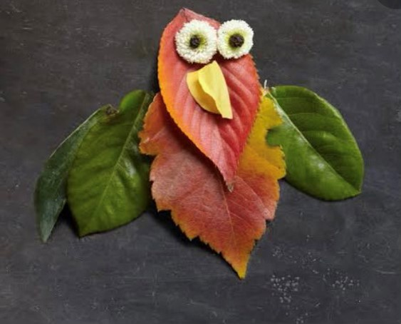
Here is some inspiration:

Slide 4
Now it’s your turn!
Make sure you ask an adult for permission to collect what you need.
You can collect some rocks, leaves, sticks, bark, flowers etc from your yard or local park.
Remember to collect your materials from the ground where possible.
Have fun and see what nature art you can create!
Don’t forget to take a photo and upload it to Google Classroom.
I can’t wait to see all your beautiful creations!!!
Click here to listen

