Slide 1
Chance
Stage 1 Week 3, Term 4

Slide 2
Lesson oVERVIEW:
Find today’s work and click on the lesson link to be taken there directly.
Monday (Week 3) - Lesson 4: Dice chance.
Thursday (Week 3) - Lesson 5: Chance bingo.

Slide 3
Lesson 4
Monday Week 3
Learning Intention: I am learning about dice chance and different possible outcomes.

Slide 4
Interactive chance Slushy game
Play the game and enjoy yourself.
CLICK HERE

Slide 5
Activity 1
You will need:
A dice or you can use the online dice.
Before you start the activity, I want you to think about…
What is the hardest number to roll?
Type your answer here
How can you find out if you are right?
Type your answer here
What is the chance of rolling a 6?
Type your answer here

Slide 6
You are going to roll the dice 10 times and record how many times a certain number was rolled using tally marks. Watch Miss Shuetrim showing you how to use tally marks and play this game.
Be sure to insert a picture of yours next to hers to compare.
What do you notice? Is anything the same or different?
Yours
Miss Shuetrim’s

Slide 7
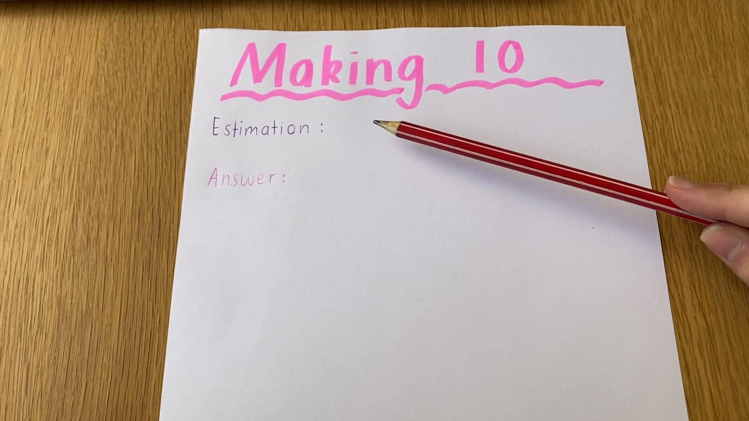
You are now going to estimate how many rolls it will take to make 10. Roll the dice and record using a number sentence. Miss Shuetrim has provided you with an example down below. Be sure to watch her video too to help you! You can insert your work next to hers to compare.
Miss Shuetrim’s
Yours

Slide 8
Repeat this but now think about how many rolls it will take you to get to 20. Don’t forget to insert an image down below.
Once you have finished answer the following questions:
What outcomes did you find were more likely to happen?
Type your answer here
What outcomes did you find were less likely to happen?
Type your answer here

Slide 9
Challenge:
This is optional and can be completed by anyone.
I want you think about what would happen when 2 dice are rolled… Would the possibility of numbers being rolled increase or decrease?
It is your turn to roll 2 dice and record the different outcomes you get when you add the 2 numbers together.
Watch the video of Miss Shuetrim explaining how to play on the next slide.

Slide 10
Challenge explained by miss shuetrim:
Watch the video to learn how to play if you would like to complete this challenge!

Slide 11
Challenge:
Post your picture here!

Slide 12
Lesson 5
Thursday Week 3
Learning Intention: I am learning about all of the different chance possibilities.

Slide 13
ADDITIONAL INTERACTIVE CHANCE GAMES
Click on the links to be taken to the fun online interactive games.
Ball Game
Vile Vender Machine

Slide 14
ACTIVITY 2
You are going to play Chance Bingo! You will need a piece of paper, a dice or an online dice and lots of coloured pencils, textas, pens or crayons etc!
Watch the video of Miss Shuetrim explaining how to play. You can insert your chance bingo board next to her video.
Insert your picture here

Slide 15
Interactive chance powerpoint
Let’s test your knowledge on what you have learnt so far!
You must open it up in Google Slides and present mode in order to play!
CLICK HERE

