Slide 1
Year two
number
Week 3, Term 4

Slide 2
table of contents
01
02
tuesday
Friday
Click here to go straight to Tuesday’s lessons.
Click here to go straight to Tuesday’s lessons.

Slide 3
tuesday

Slide 4
Number talk

Slide 5
Beat the teacher

Slide 6
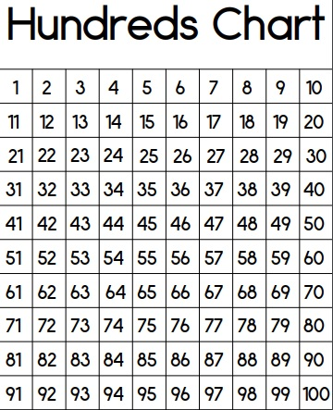
Counting practice
Practice counting out loud:
Count forwards by 3s to 100.
Start at 25 and count forwards by 10s stopping at 85.
Now count backwards by 10s from 85 back to 25.

Slide 7
FOLLOW UP TASK 1
Using the numbers below, make as many different numbers as you can.
208, 515, 792
What is the largest number you can make?
What is the smallest number you can make?
Can you order the numbers from smallest to largest?
Type your answers below or write on paper and upload over this slide.

Slide 8
FOLLOW UP TASK 2
Using the numbers below, make as many different numbers as you can.
3250, 5604, 4220
What is the largest number you can make?
What is the smallest number you can make?
Can you order the numbers from smallest to largest?
Type your answers below or write on paper and upload over this slide.

Slide 9
Friday

Slide 10
Number talk - estimation

Slide 11
Counting practice
Practice counting out loud:
Start at 15 and count forward by 3s. Stop when you get to 72.
Start at 100 and count backwards by 4s.
Start at 6 and count forward by 6’s.

Slide 12
Number of the day

Slide 13
Number of the day follow up task
Make a Number of the Day poster for the number 624.
Upload it on this slide.

Slide 14
ALTERNATIVE RESOURCES
2nd grade

