Slide 1
Pobble Writing T4 Wk 3
Volcano https://www.pobble365.com/

Slide 2
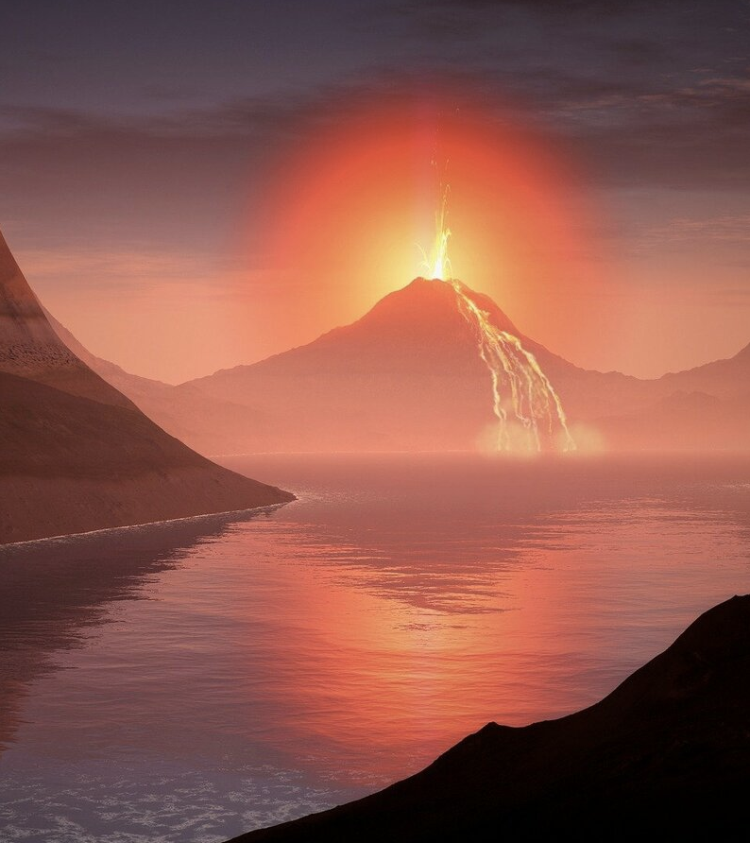
Take a good look at this weeks image: Volcano

Slide 3
Read the STORY STARTER BELOW about the photograph:
It was the moment they had been dreading for decades: the volcano had finally erupted. The earth shook, as torrents of golden death cascaded over the helpless landscape. Clouds of ash swarmed over the countryside, enveloping everything in their path. Chaos reigned as the beast that had been sleeping for years, now awoken, inflicted its fury upon the world.
The sky glowed like molten iron. The world was on fire. It was natures turn to take its revenge.
Clarifying words in the text (PAUSE AND READ EACH MEANING TWICE!)
decades: a period of ten years.
erupted: become active and eject lava, ash, and gases.
torrents: a strong and fast-moving stream of water or other liquid.
cascaded: pour downwards rapidly and in large quantities.
Chaos: complete disorder and confusion.
Reigned: the dominant feature of a situation or place.
inflicted: cause (something unpleasant or painful) to be suffered by someone or something.
Fury: wild or violent anger.

Slide 4
QUESTION TIME:
Read each question carefully, there is space for you to answer each question underneath.
HINT:Try and write using full sentences and use conjunctions where possible to extend your answers.
Q1) What do you think it means by ‘nature taking its revenge’?
A)
Q2) What do you think is the most dangerous part of a volcano?
A)
Q3) Do you know of any active volcanoes around the world?
A)

Slide 5
QUESTIONS CONTINUED..
Q4) Do you know what causes a volcano to erupt?
A)
Q5) There is a famous volcano called Vesuvius, which erupted in Roman times to destroy the citizens of Pompeii. How do you think people felt thousands of years ago when they saw a volcanic eruption?
A)
Q6) How do you think people explained where the lava came from? Remember, people used to think the Earth was flat!
A)

Slide 6
Grammar/punctuation challenge
Verbs are action/doing words.
Q. Which sentence(s) contains two verbs? Type/Write the correct answer below
The volcano erupted an oozing, orange lava.
Lava exploded out of the volcano, bubbling over the landscape.
The sky glowed.
The ash-cloud shot over the land, rising high up into the sky.
A:

Slide 7
Sentence Challenge: Must Do
These sentences are ‘sick’ and need help to get better. Please help!!
Lava went over the ground. The sky looked red. It was a scary sight.
Can you think of a way to improve these sentences? Type your answers below:

Slide 8
Extension: (Optional)
Draw your own volcanic eruption.
You could label it with some adjectives or even
sentences to describe what is happening.
Photo courtesy of Reimund Bertrams from Pixabay.
There is a really good volcano drawing activity in Art for Kids Hub
How to draw a Volcano

