Slide 1
Grammar Lesson - Adjectives
Learning intentions:
​I can use adjectives to help me describe something.
I can write sentences with capital letters and full stops.
I can use compound sentences in my writing​.
Instructions:
Follow the instruction on each slide to complete the lesson.
You can print out slides 4 and 5 to write on, write your answers in your work book or a piece of paper, or type your answer straight onto the slides.
To type on the slides, double click in the box provided and use the keyboard to type your answers.
Your work automatically saves!

Slide 2
Click on the play button to watch this Adjectives video.

Slide 3
Click on the play button to watch this Adjectives and Adverbs video.

Slide 4
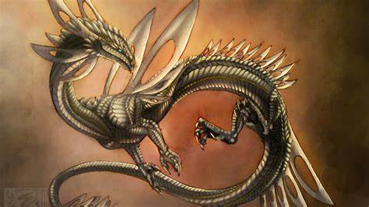
Print and (write) or (type) 5 adjectives that describe the dragon (one adjective in each box). An example has been done for you.
Scaly

Slide 5
Type a sentence using at least two of your listed adjectives. Alternatively, you can write your sentence in your exercise book.
Optional activity: Type or write additional sentences that include all five adjectives.

