Slide 1
https://www.youtube.com/watch?v=4liJs2sbi88

Slide 2
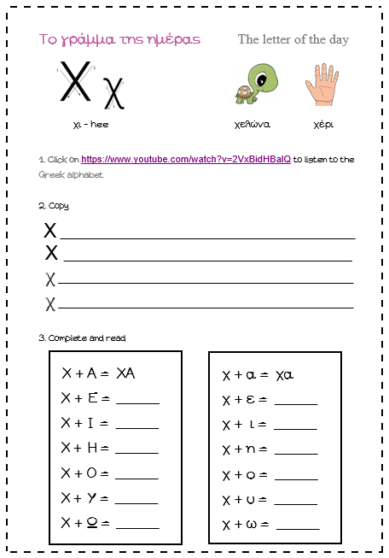
https://www.youtube.com/watch?v=2VxBidHBalQ

Slide 4
Letter of the day bracelet or bookmark

