Slide 1
Stage 1
Procedures
Click on the day of the week to view the lesson
Monday
Tuesday
Wednesday
Thursday
Friday

Slide 2
Monday

Slide 3
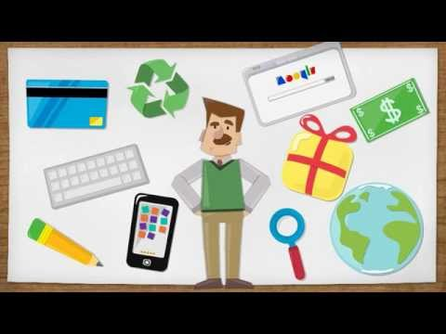
Procedure Writing - Revision

Slide 4
Procedure Text Structure
Title
This is a clear statement about what you are going to do or make.
Materials/Ingredients
This is a list of items that you will need to complete the task.
Method
This is a series of ordered steps explaining how to complete the task

Slide 5
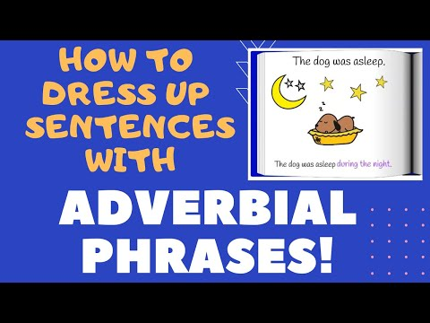
Adverbial Phrases - Revision
An adverbial phrase is a group of words that act together as an adverb, giving more information about a verb, adjective, or other adverb in a sentence.
The adverbial phrase answers the same questions as a regular adverb: how/how much, when, or where.

Slide 6
Adverbial Phrases
Underline the adverbial phrase in the following sentences.
Does it tell us how, how much, when or where?
Write the word next to the sentence.
For example: We expect our grandparents to arrive in about an hour (when)
My sister cooks almost as much as you do.
Mum will pick us up after school today.
Your brother plays soccer better than my brother does.

Slide 7
Adverbial Phrases
Create two sentences that include an adverbial phrase in each sentence. Write the adverbial phrase in green. An example has been provided for you.
Example: He finished his homework in a rush.

Slide 8
Click on the Kahoot to test your understanding of adverbial phrases.

Slide 9
Tuesday

Slide 10
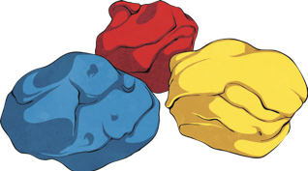
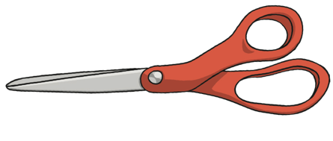
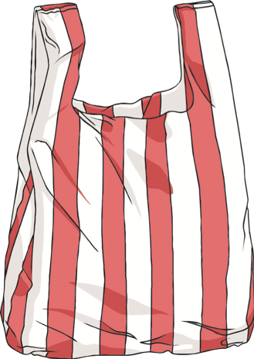
Procedure - How to Make a Parachute
(If you don’t have these items you can still complete your writing task and watch the video):
Plastic bag
Scissors
Cotton thread
Black marker
Pencil
Hole puncher
Small toy

Slide 11
How to Make a Parachute
Click on the link to view the video -
How to Make a Parachute
Now it’s your turn to make a parachute! Don’t forget to collect all of the materials you need and get permission from an adult before you begin.
Remember to listen out for all the common nouns, action verbs, adverbs and adverbial phrases used in the video so you can use them when you write your procedure.
Have fun!!

Slide 12
Wednesday

Slide 13
Procedure - How to Make a Parachute
Click on the link to view the Modelled Writing video on how to write your procedure - How to Make a Parachute
After making our parachute yesterday, we will be composing our writing of our procedure today.

Slide 14
Composing -
How to Make a Parachute
Write your procedure on ‘How to Make a Parachute’
Don’t forget to include a title, materials, and the method in order.
Try to use some of these if you can:
time connectives (first, next, then, after that, finally)
action verbs (place, grip, cut)
adverbs to tell us when, where or how something happened.
adverbial phrases to tell us more about the verb or adjective.

Slide 15
Thursday

Slide 16
Writing - Editing / Revising
Once you have written your procedure you will need to edit and revise your writing. Make sure you have watched the Modelled writing video so you know how to edit and revise your writing correctly.
Helpful hint: You can use a red pencil for editing and a green pencil for revising.

Slide 17
Friday

Slide 18
Publishing
Publish your work in one of the following ways:
Write your procedure in your best handwriting or type up your procedure and draw a picture of your parachute or you may like to take a photo.
You might be an author putting your procedure in a kids magazine!
The Stage 1 teachers can’t wait to see what you present!

Slide 19
This week you have:
Revised the structure of procedures
Revised adverbial phrases
Learned how to make a parachute
Composed a procedure using the correct structure and language
Edited and revised your writing
Published your writing.

