Slide 1
Week 10 Art Lesson with Mrs Hawkins
Click on the speaker button throughout
this presentation to hear the instructions.

Slide 2
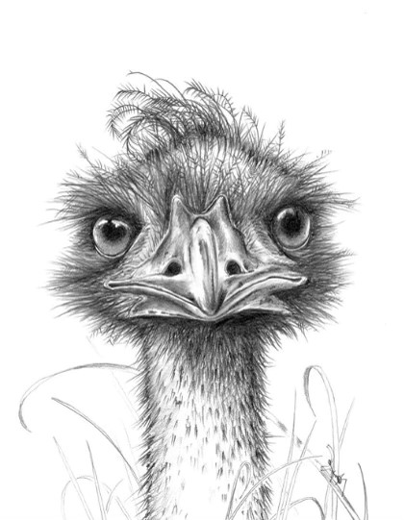
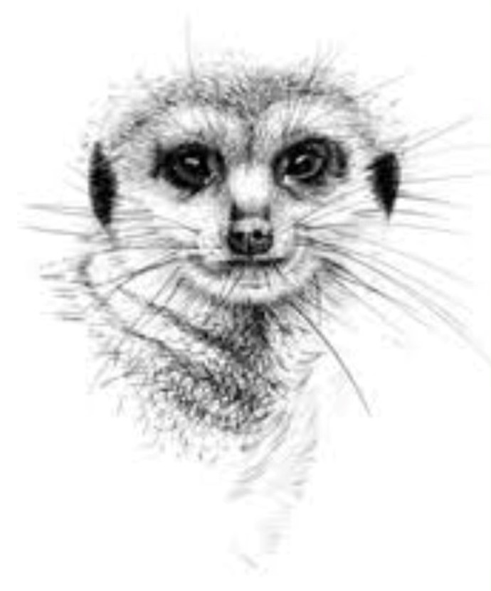
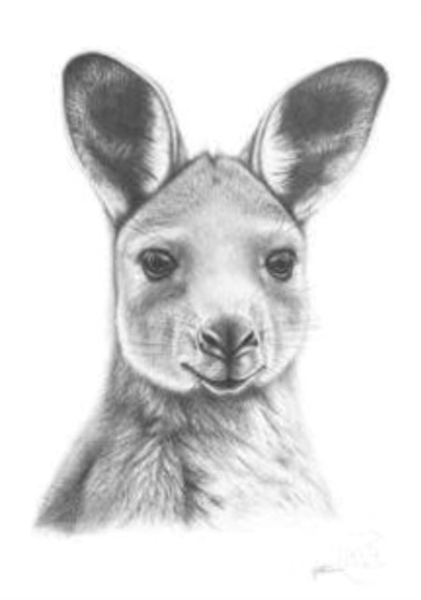
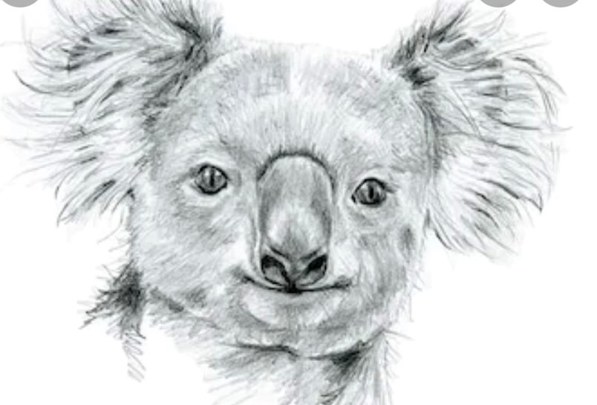
Hi Everyone,
How are you?
I know you have been learning about animals! Some of you had the opportunity to go on a Zoom with a Ranger at Symbio Wildlife Park and learn all about the animals and see them in their enclosures.
So I thought it would be nice to do an art lesson related to this. I hope you enjoy it! Have a go and see what you can create!

Slide 3
You will need:-
To print off a black and white animal face of your choice. I chose the Koala. (If you don’t have a printer, you could look through a newspaper or magazine for animal pictures or you could just have the image on your screen and copy it from there).
You will need a second piece of paper
a lead pencil
an eraser
scissors
glue stick
cardboard to lean on and protect your table.

Slide 4
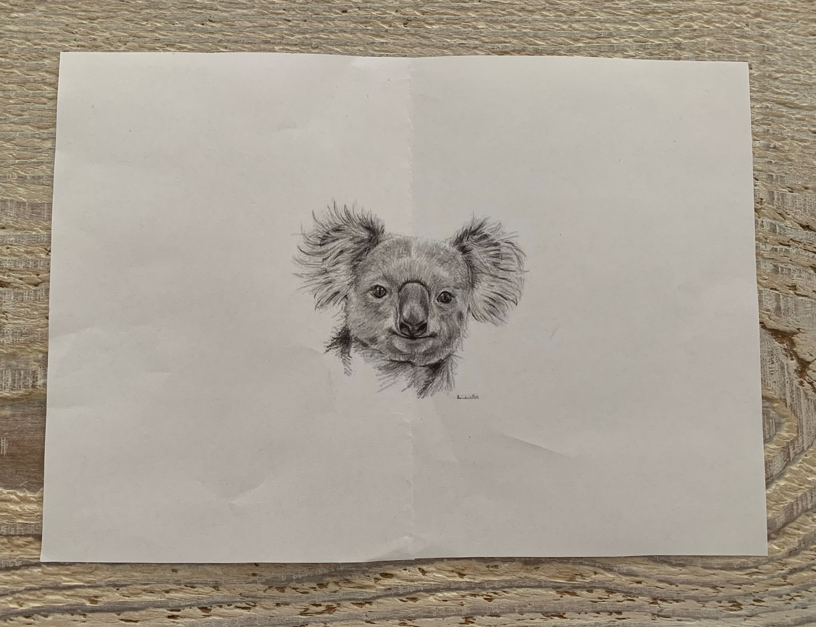
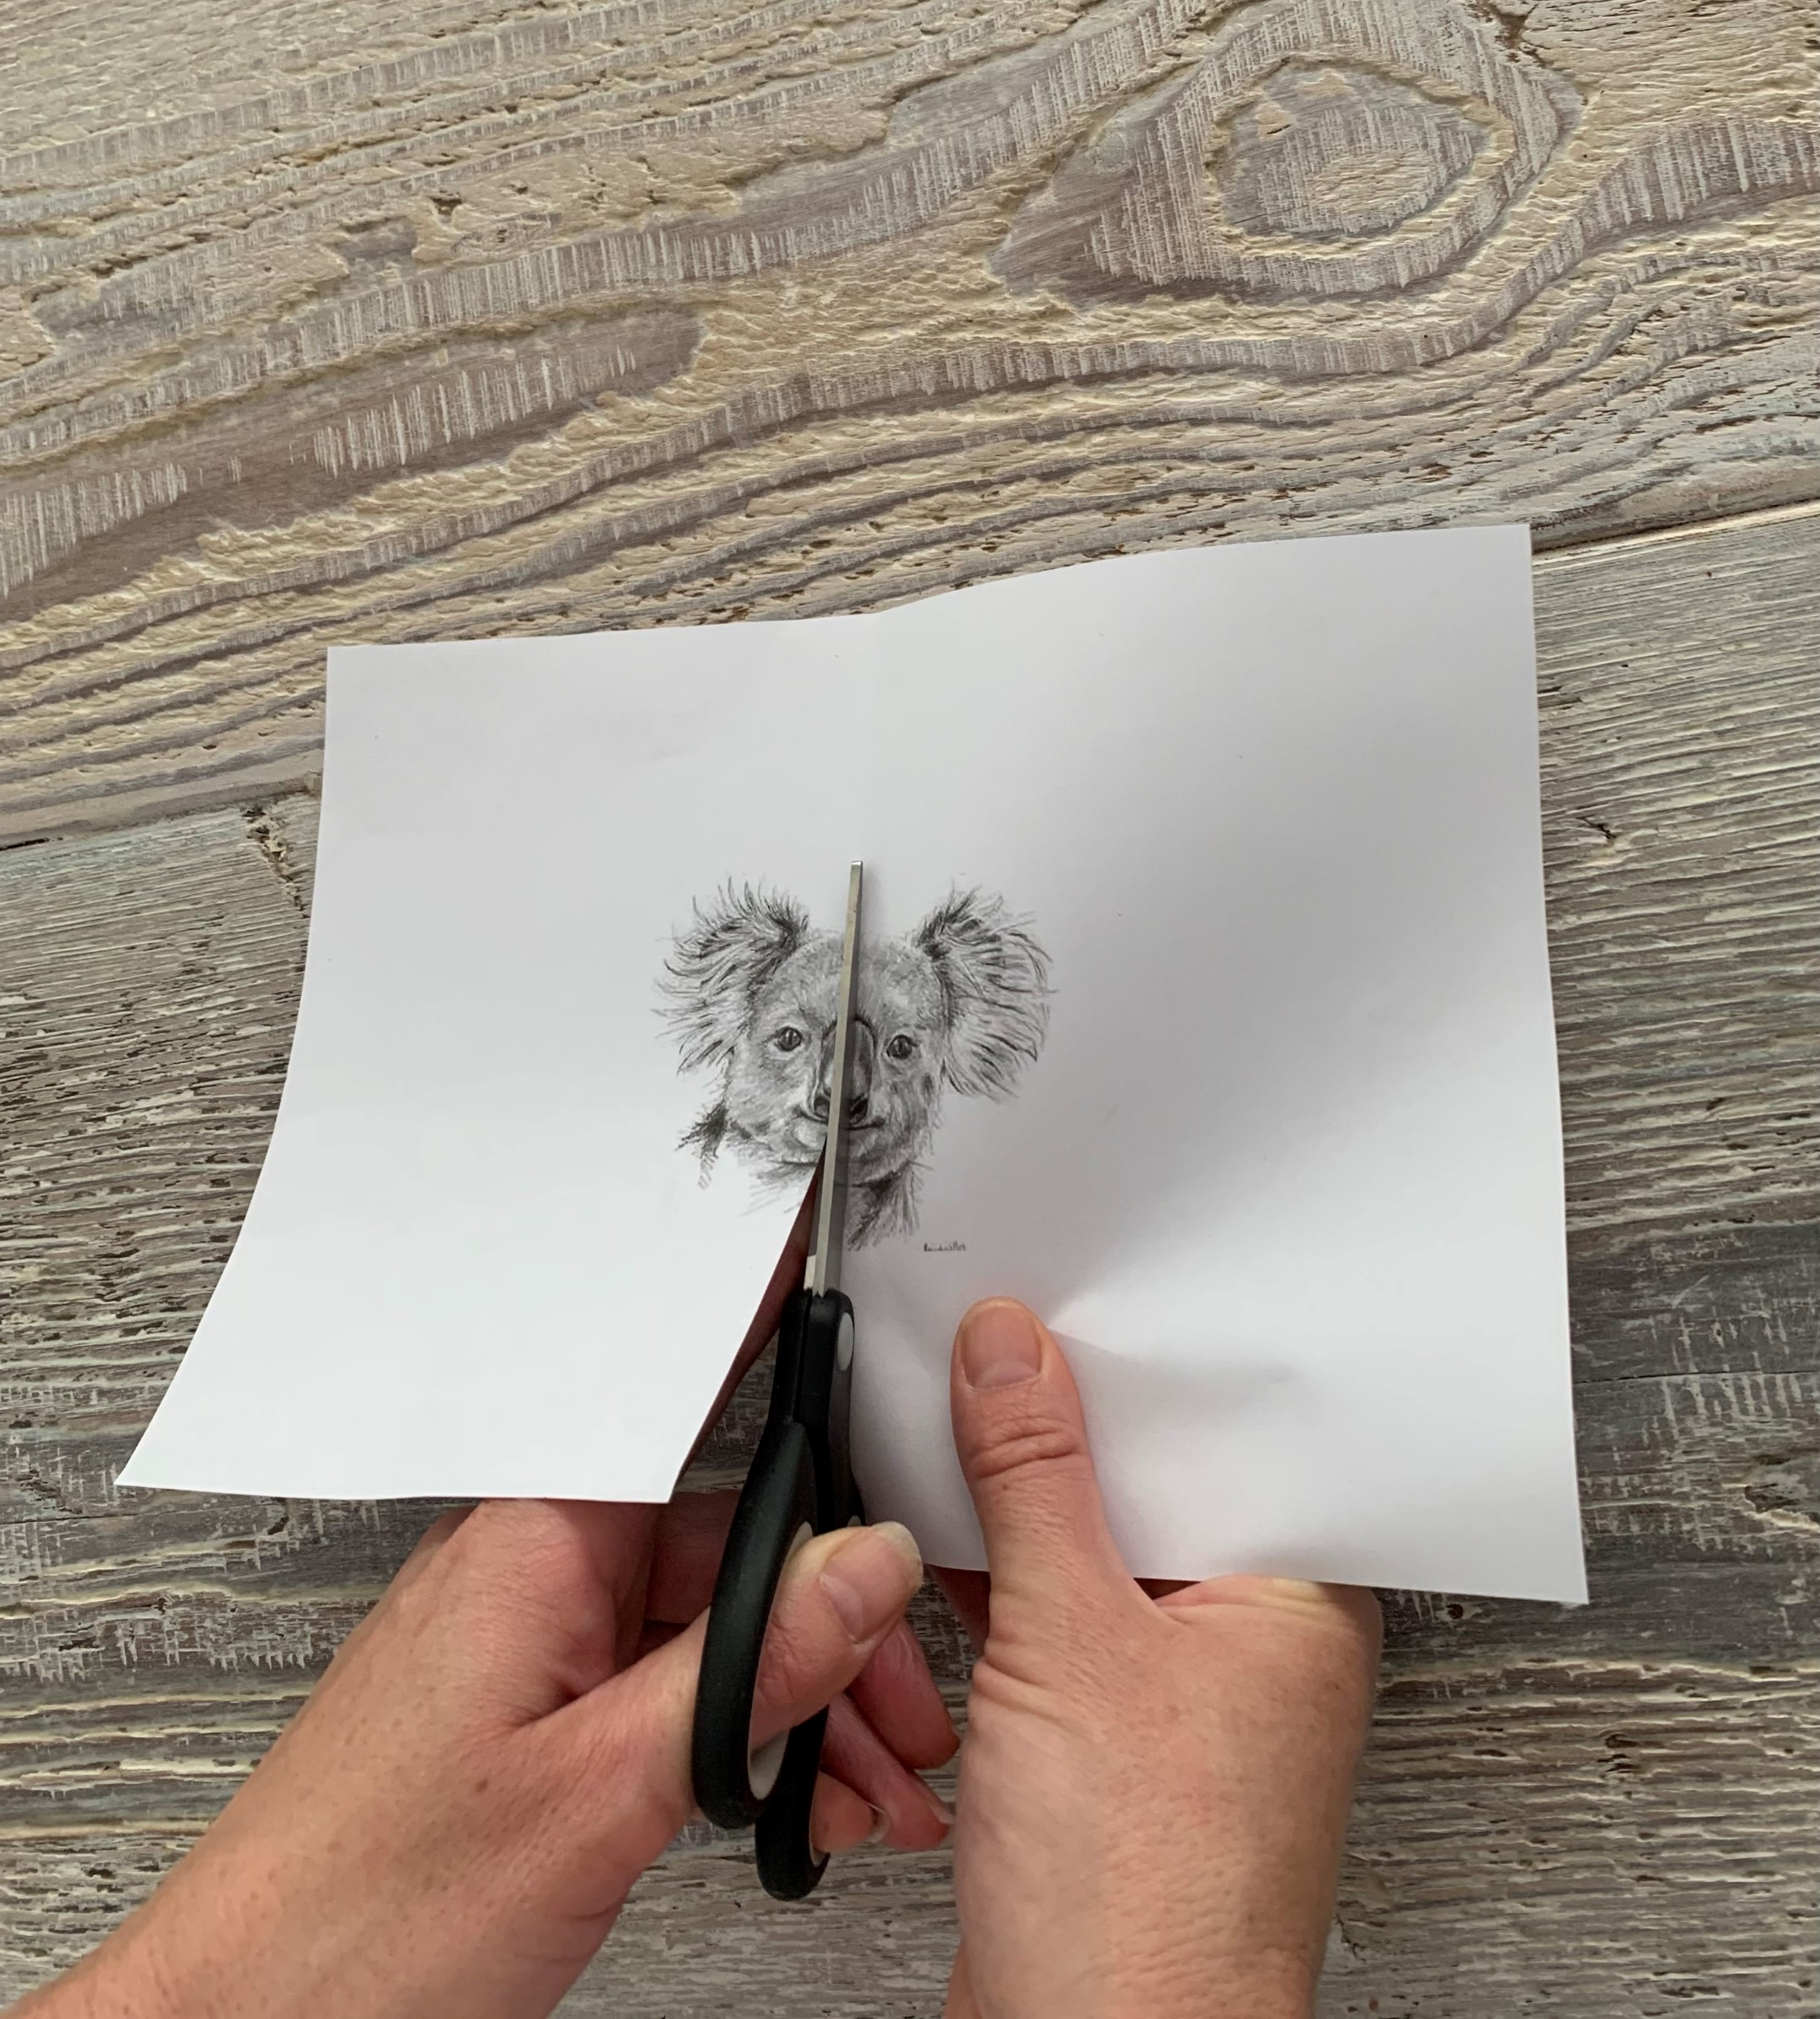
Step 1: Choose an animal you like.
Go on the internet and search for an image of that animals face in black and white.
If you can print it off, do so.
If you don’t have a printer just keep it on your screen to copy from.
Or find an animal picture in a magazine or newspaper.
Step 2: Fold your piece of paper in half.
Step 3: Cut down the middle of the animals face
along the fold.

Slide 5
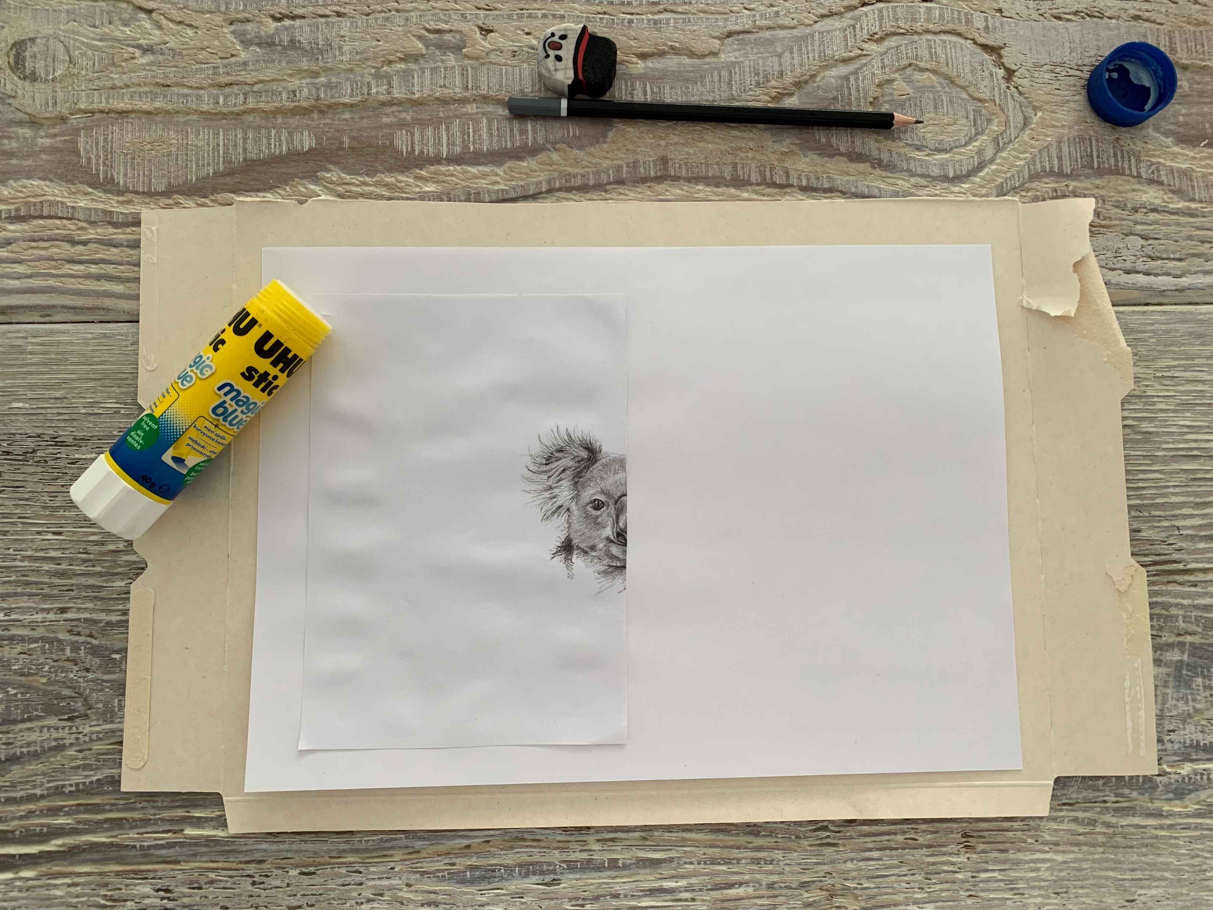
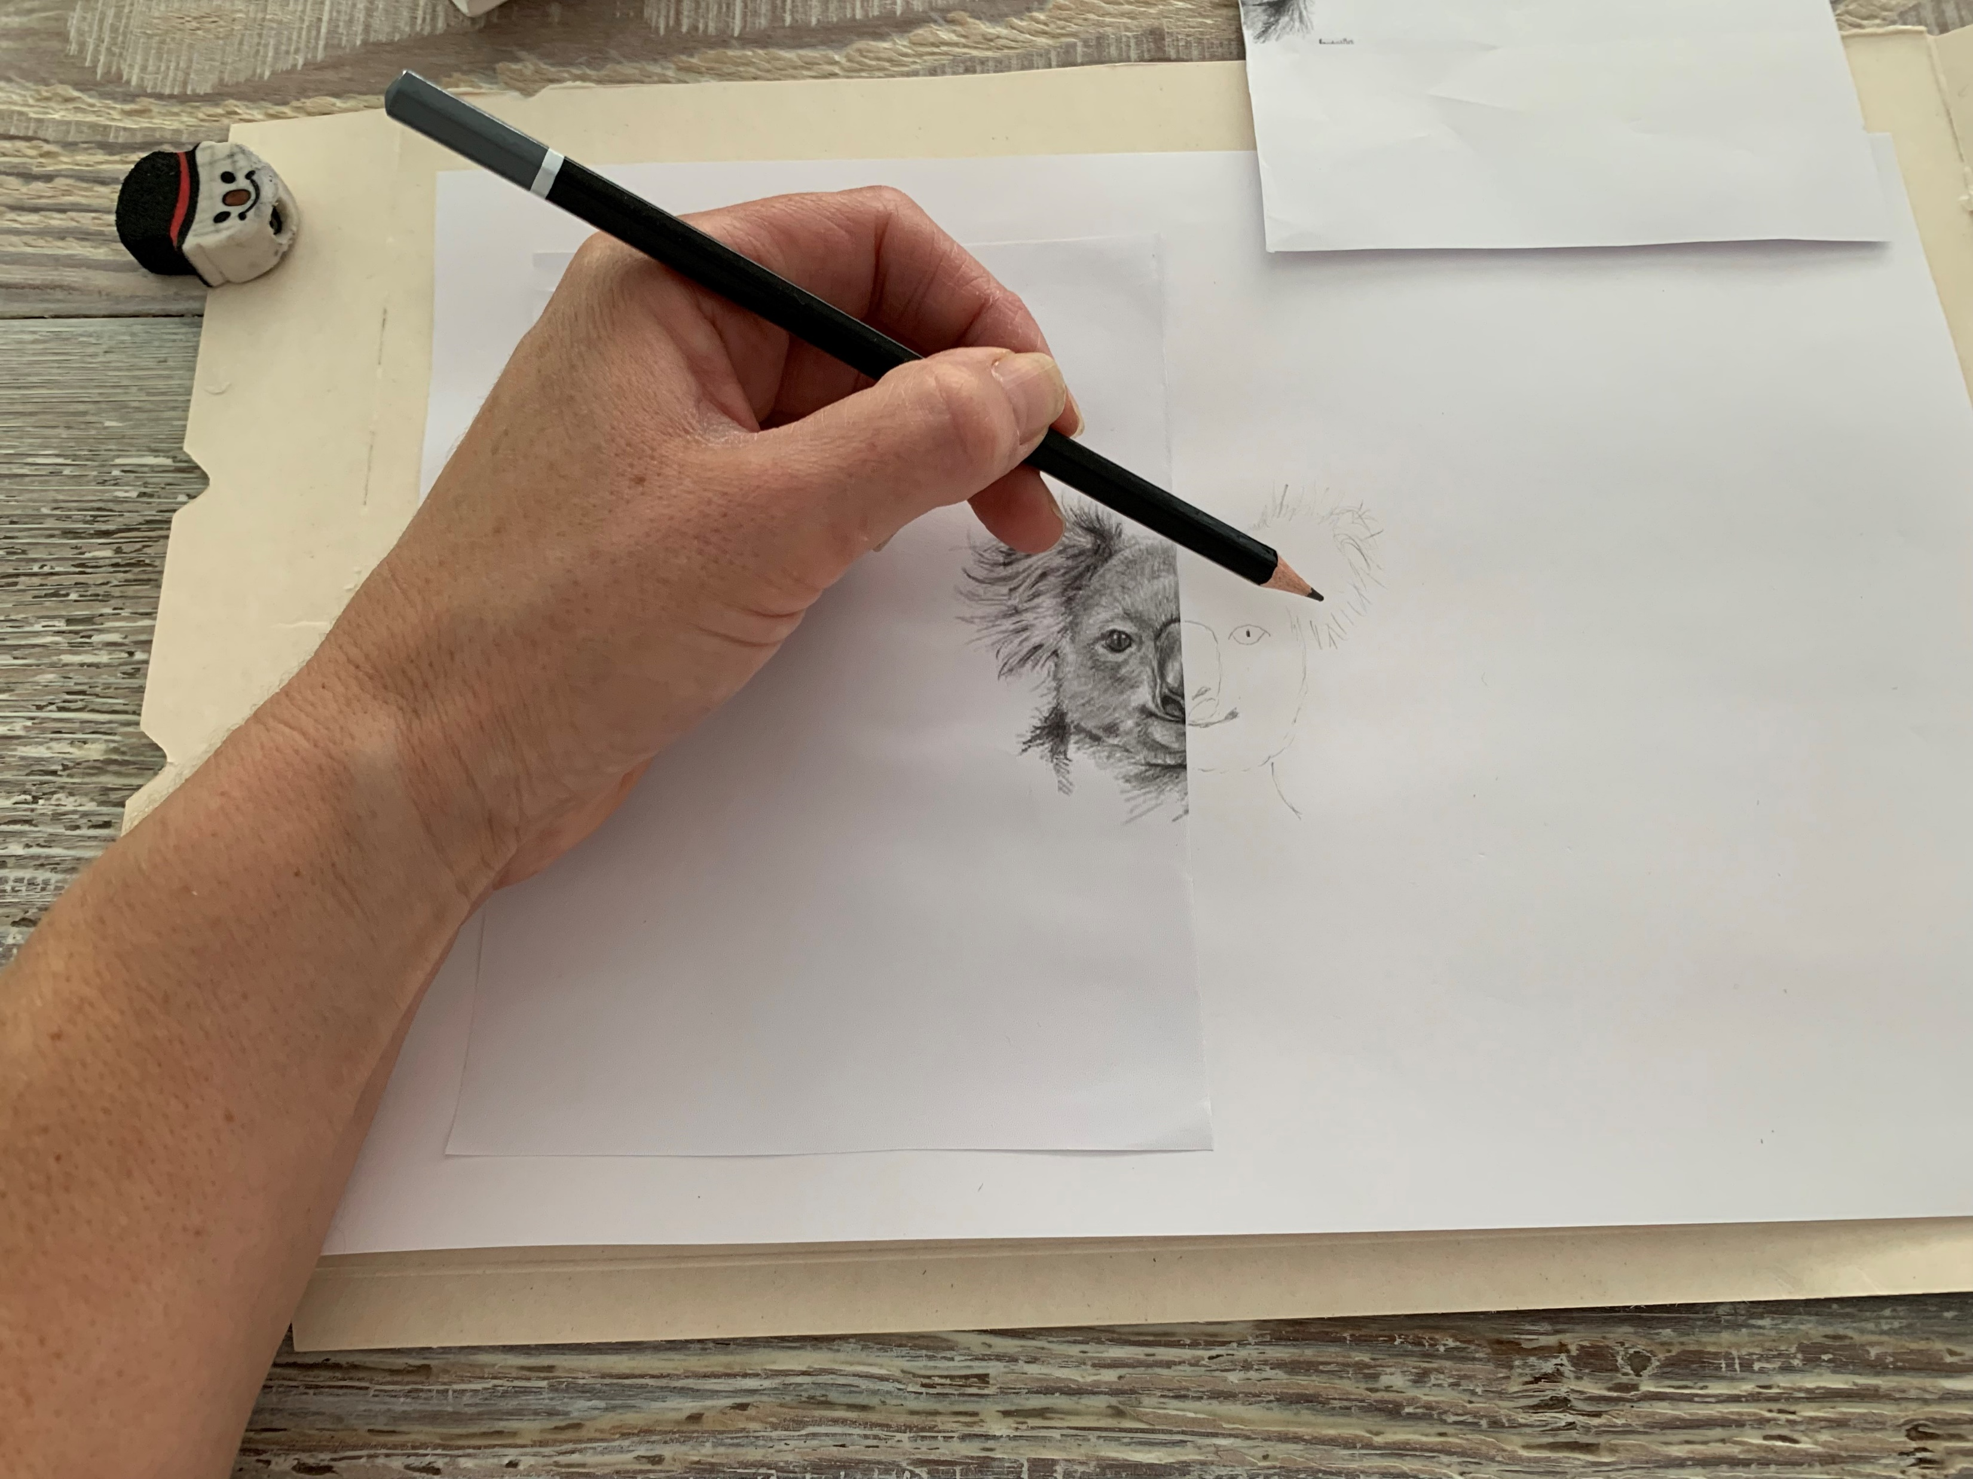
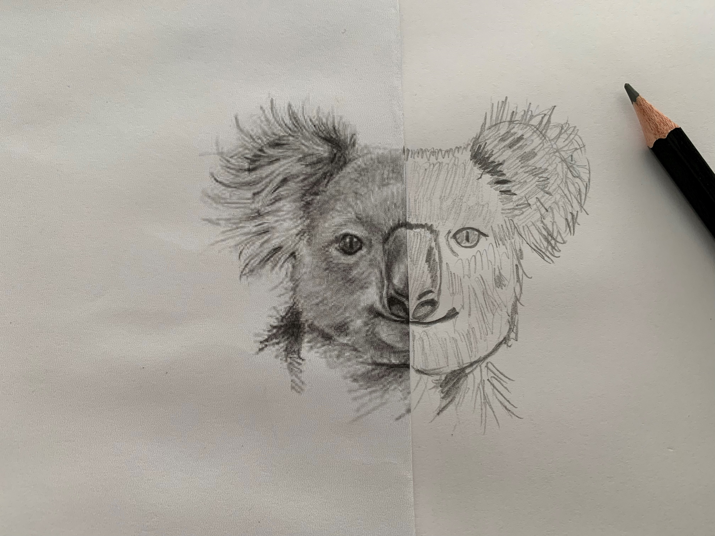
Step 4: Glue the first half of the animals face onto your piece of white paper.
Step 5: Start sketching the other side by looking at the image and adding the detail bit by bit.
Step 6: Continue adding detail until complete. Upload a photo into Google Classroom in the art section so I can see your amazing Art work! Have fun!

Slide 6
I hope you enjoyed todays Art lesson! Have a good week and Enjoy the school holidays! See you all next Term! Take care and bye for now.

