Slide 1
Pobble Writing Week 10
The Greatest Library https://www.pobble365.com/

Slide 2
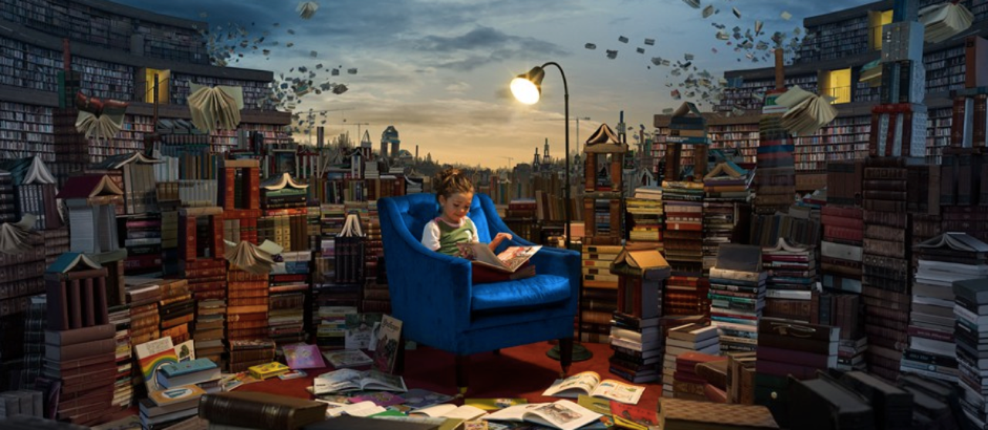
Take a good look at this weeks image: The Greatest Library

Slide 3
Read the STORY STARTER BELOW about the photograph:
The books had minds of their own.
This was no ordinary library.
Books about knights and castles would gallop all over the library, bravely and boldly ordering the other books around. The books about thieves would sneak around, lurking behind bookshelves in the shadows. Books about wild animals would occasionally roar and bite other books. The ones containing stories set in the winter would often shiver, covering their neighbours with snow and frost.
Lucy loved this place like no other. Reading was the most exciting thing in the world here: everything she read seemed to come alive out of the pages…
___________________________________________________________________________
Boldly: in a confident or courageous way shiver: to shake or tremble with cold, fear or excitement
Lurking: remaining hidden containing: having (in this context)
Occasionally: from time to time (sometimes)

Slide 4
QUESTION TIME:
Read each question carefully, there is space for you to answer each question underneath.
HINT:Try and write using full sentences and use conjunctions where possible to extend your answers.
Q1) Why do you think the little girl enjoys being in this library so much?
A)
Q2) What book do you think she is reading?
A)
Q3) Can you tell anything about a person by the types of books they read?
A)

Slide 5
QUESTIONS CONTINUED..
Q4) If you could write a book, what would it be about?
A)
Q5) Which type of books would you like/not like to come alive?
A)
6) If you were to take out every single book from a library would it still be a library?
A)
Q7) What improvements would you make to our school library?
A)

Slide 6
Sentence Challenge
These sentences are ‘sick’ and need help to get better. Please help!!
Lucy sat in the chair. The books started to move. It felt like magic.
Can you think of a way to improve these sentences? Type your answers below:
Extension: (Optional)
Draw a picture of your favourite book coming alive.
Think about whether it would be friendly or nasty!
Will it behave like one of the main characters perhaps?
Photo courtesy of Erik Johansson.
www.erikjo.com

