Slide 1
Stage 1
Procedures
Click on the day of the week to view the lesson
Monday
Tuesday
Wednesday
Thursday
Friday

Slide 2
Monday
Week 7

Slide 3
What is a Procedure?
Procedure texts inform how to do or make something through a series of steps.
There are many types of procedure texts, such as:
recipes
instructions
directions
rules

Slide 4
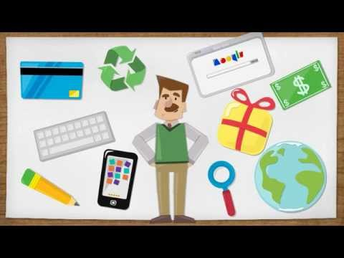
What is a Procedure?
Watch the video about procedures.

Slide 5
What is a Procedure?
After watching the video discuss with an adult:
Why do people write procedures?
What sections might you find within a procedure?
How might pictures and diagrams be helpful in a procedure?

Slide 6
Procedure Text Structure
Title | This is a clear statement about what you are going to do or make.
Materials/ Ingredients | This is a list of items that you will need to complete the task.
Method | This is a series of ordered steps explaining how to complete the task.

Slide 7
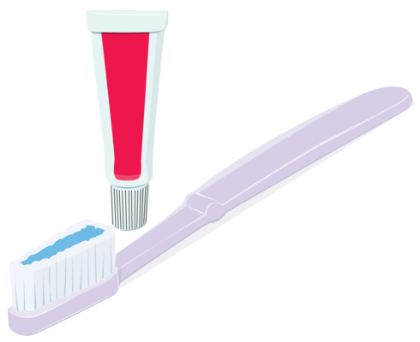
Procedure Example:
How to brush your teeth
Materials
Toothbrush
Toothpaste
Water
Method
Squeeze some toothpaste on the toothbrush.
Put your toothbrush under some water.
Brush your teeth thoroughly for three minutes.
Rinse your mouth and the toothbrush with water.

Slide 8
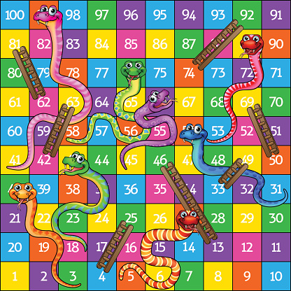
How to play Snakes and Ladders
Click on the links to access the game board.
You will need a dice, counters and someone to play with.
Once you have played the game, complete the snakes and ladders sequencing activity. If you do not have a printer, you can reorder the instructions and type them on the next slide.

Slide 9
Move the steps into the correct order

Slide 10
How to play Snakes and Ladders
Order | Steps
1
2
3
4
5
6

Slide 11
Upload a photo of you playing Snakes and Ladders and a photo of your work for your teacher!

Slide 12
Tuesday
Week 7

Slide 13
Action Verbs

Slide 14
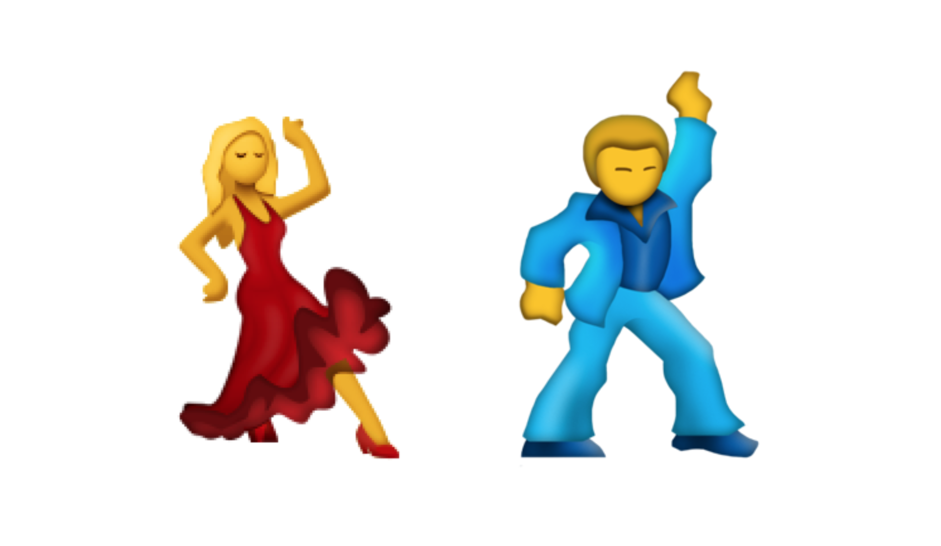
What are action verbs?
Action verbs are words that tell us what is happening. For example they danced all night.

Slide 15
Please click on the video below to access more examples of action verbs.

Slide 16
Type a sentence using the action verbs on the next few slides.
Two examples have been done for you.
Ran - I ran across the bridge to find out what was happening.
Jumped - I jumped so high on my trampoline that I almost hit a bird that was flying past.

Slide 17
Now it’s your turn!
Played -
Kicked -

Slide 18
Talked -
Yelled -

Slide 19
Optional activity: Think of your own action verb and add it into a sentence.

Slide 20
Wednesday
Week 7

Slide 21
Common Nouns

Slide 22
What are common nouns?
A common noun is a word that names a person, place, thing or animal. It is known as a ‘naming word’.

Slide 23
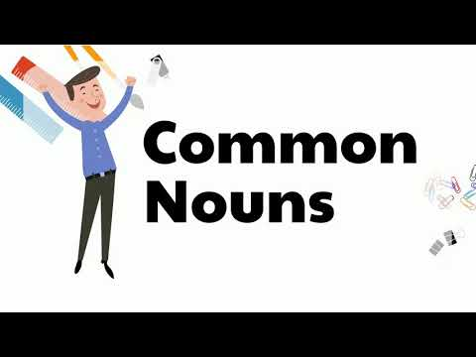
Please click on the video to find out more examples of common nouns.

Slide 24
Common Nouns
The following common nouns have been jumbled up. You must sort these words into the appropriate slide and column. They are either people, places, things or animals. Good luck!
pilot, elephant, airport, chocolate, dolphin, book, teacher, school, cat, girl, beach, baby, dog, computer, library, kangaroo, house, park, doctor, mouse, nurse, dance studio, soccer ball.

Slide 25
Examples have been provided for you
People
Example: Teacher
Place
Example: Beach

Slide 26
Thing
Example: Soccer ball
Animal
Example: Dog

Slide 27
Write a couple of sentences using all four common nouns. A person, place, thing and animal. You can either use common nouns from the previous list or create your own. Try and use adjectives in your writing. What you learnt about last week! This will make your sentence more descriptive.
Example: Kate went for a walk to the breathtaking beach nearby her house with her dog Milo. She brought Milo’s squishy toy along so that she could play fetch with Milo.
Your turn:

Slide 28
Thursday
Week 7

Slide 29
Procedure: How to Make Fairy Bread
Click on the link to view the video on how to make fairy bread.
Now it’s your turn to make it! Don’t forget to make sure you have all of your ingredients and you have an adults permission before you begin.
Have fun!!

Slide 30
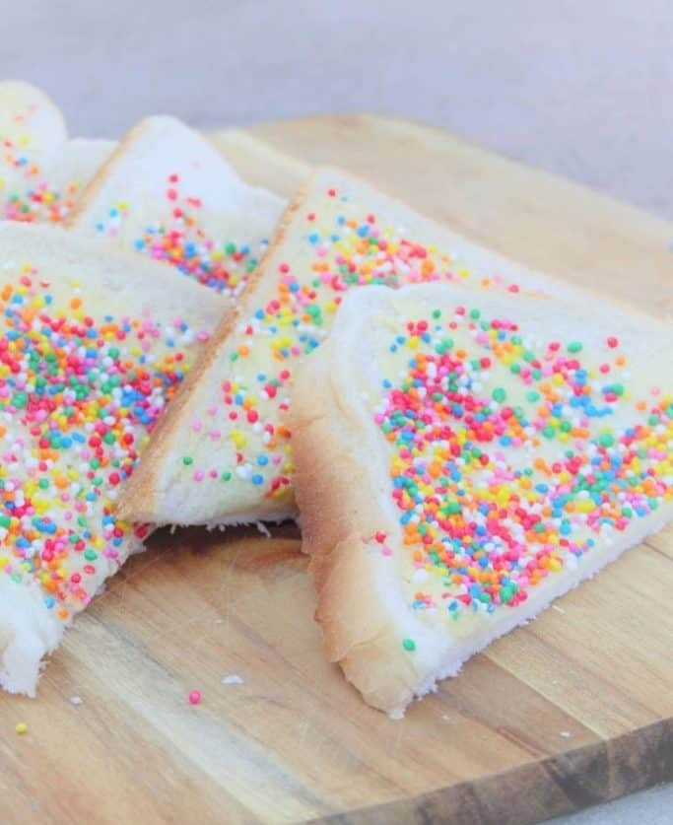
Writing - Composing: How to make fairy bread
Now it’s your turn!! Write your procedure on how to make fairy bread.
Don’t forget to include a title, ingredients, utensils and the steps in order.
Try to use some vocabulary words:
time connectives (first, next, then, after that, finally)
action verbs to describe the steps you used to make your fairy bread (place, spread, cut)

Slide 31
Writing - Editing / Revising
Once you have written your procedure you will need to edit your writing. Do this by checking for capital letters and full stops. Re read your writing and check it makes sense. Underline any spelling words you may think may not be right and see if you can fix them or ask an adult to help you.
Helpful hint: I always like to use a different colour to edit my work. It makes it easier to fix when I’m publishing my writing.

Slide 32
Friday
Week 7

Slide 33
This week you have learnt about:
What a procedure is.
The different types of procedures there are.
The purpose of writing and using a procedure.
How to write a procedure using the correct structure and language focusing on common nouns and command verbs
How to follow a procedure to achieve the desired outcome

Slide 34
You even got to make ‘Fairy Bread’
Your final activity this week is to publish the Fairy bread procedure you wrote yesterday and upload it for your teacher to see………...

Slide 35
How creative can you be……
You may like to present it in one of the following ways, a combination of the ideas below or you could come up with something really unique and different. It is entirely up to you.
Write your procedure in your best writing and draw a picture of your fairy bread or you eating your fairy bread.
Type up your procedure and add a photo of you making or eating your fairy bread.
You might be a chef putting your recipe in a kids cookbook.
The stage 1 teachers can’t wait to see what you present!!!!

