Slide 1
Stage 1
Procedures
Click on the day of the week to view the lesson
Monday
Tuesday
Wednesday
Thursday
Friday

Slide 2
Monday
Week 8

Slide 3
Procedure Text Structure
Title | This is a clear statement about what you are going to do or make.
Materials/ Ingredients | This is a list of items that you will need to complete the task.
Method | This is a series of ordered steps explaining how to complete the task.

Slide 4
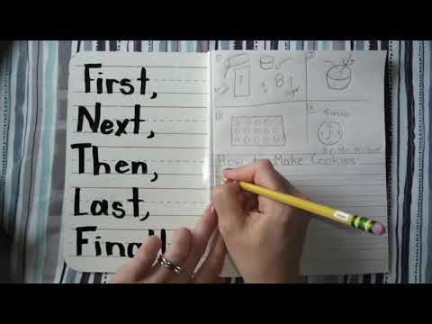
Procedures
Click on the video to revise your knowledge on Procedures

Slide 5
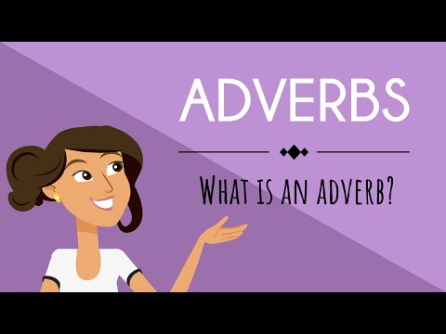
Adverbs
What is an adverb? Adverbs are best known as being words which give us more information about verbs.
For example she ran quickly to the gate.

Slide 6
Adverb examples: When, where and how something happens
I would like to eat now!
You can eat after.
Pour the liquid inside the jar.
Place the jar over here.
Carefully cut the bread in half.
Thoroughly wash your hands before you start preparing food.
I

Slide 7
Highlight the adverbs in the following sentences
The dog happily wagged his tail and jumped up and down.
The dog always wagged his tail and jumped excitedly.
Create your own sentence using two adverbs below.

Slide 8
Tuesday
Week 8

Slide 9
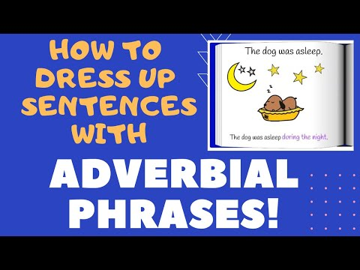
Adverbial Phrases
Adverbial phrases are two or more words that tell us more about a verb or adjective. Adverbial phrases appear as part of a sentence and tell us how, where, when, how long or why.

Slide 10
Examples of Adverbial Phrases
With a smiling face, he accepted his school award. Adverbial phrase tells us HOW.
Milo liked to sleep in the sun. Adverbial Phrase tells us WHERE.
It took five minutes to make the fruit salad. Adverbial phrase tells us HOW LONG.
Carefully put the plate down so you don’t spill the food. Adverbial phrase tells us WHY.

Slide 11
Challenge:
can you dress up these sentences?
The dog ran.
The dinosaur roared.

Slide 12
Writing a Procedure:
Revisiting Grammar you have Learnt.
Procedure Example: Brushing your teeth
Squeeze some toothpaste onto your toothbrush. (common nouns)
Put your toothbrush under some water. (action verb)
Brush your teeth thoroughly for three minutes. (adverb)
Rinse your mouth and the toothbrush with water. (adverbial phrase)

Slide 13
Wednesday
Week 8

Slide 14
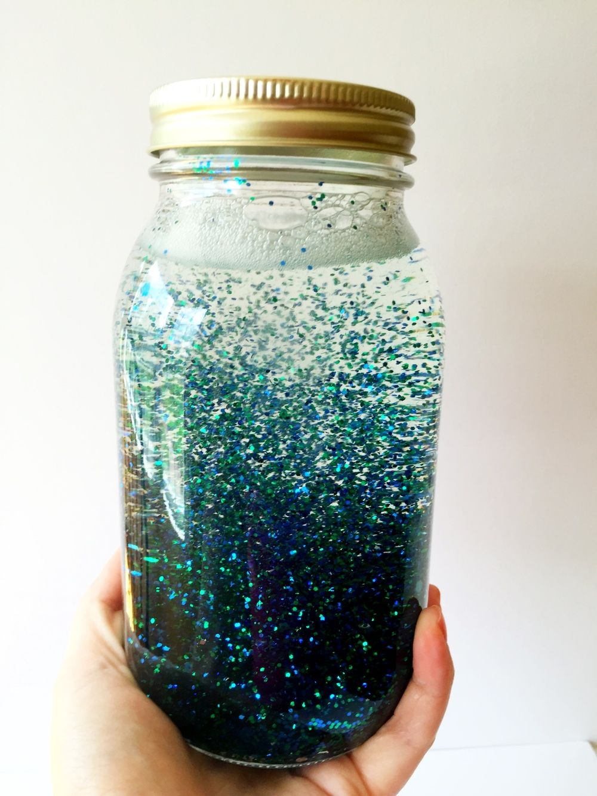
For today’s activity you will need some materials
(If you don’t have these items you can still complete your writing task and make your mindfulness jar later):
A jar with a lid
Warm water
Glitter
Craft stars/shapes/sequins
Clear/glitter glue (optional)
Food colouring (optional)

Slide 15
Procedure:
How to Make a Mindfulness Jar
Click on the link to view the video on Making a Mindfulness Jar.
Now it’s your turn to make a mindfulness jar! Don’t forget to collect all of the materials you need and get permission from an adult before you begin.
Remember to listen out for all the common nouns, action verbs, adverbs and adverbial phrases used in the video so you can use them when you write your procedure.
Have fun!!

Slide 16
Thursday
Week 8

Slide 17
Procedure-How to Make a Mindfulness Jar
Click on the link to view the Modelled Writing video on how to write your procedure.
After making our mindfulness jar yesterday, we will be composing our writing of our procedure today.

Slide 18
Writing - Composing:
How to Make a Mindfulness Jar
Write your procedure on how to make a mindfulness jar.
Don’t forget to include a title, materials, and the method in order.
Try to use some of these if you can:
time connectives (first, next, then, after that, finally)
action verbs (place, spread, cut)
adverbs to tell us when, where or how something happened.
adverbial phrases to tell us more about the verb or adjective.

Slide 19
Friday
Week 8

Slide 20
Writing - Editing / Revising
Once you have written your procedure you will need to edit your writing. Make sure you have watched the Modelled writing video so you know how to do this. Do this by checking for capital letters and full stops. Re read your writing and check it makes sense. Underline any spelling words you may think may not be right and see if you can fix them or ask an adult to help you. Revise your writing by adding any words you think might make your procedure sound more interesting.
Helpful hint: You can use a green pencil for revising and a red pencil for editing like we have shown in the video.

Slide 21
This week you have:
Revised the structure of procedures
learned about adverbs
learned about adverbial phrases
learned how to make a mindfulness jar
composed a procedure using the correct structure and language
focused on editing and revising your writing to check that it makes sense and has the appropriate punctuation

Slide 22
Your final activity this week is to publish the Mindfulness Jar Procedure you wrote yesterday and upload it for your teacher to see………...

Slide 23
How creative can you be……
You may like to present it in one of the following ways, a combination of the ideas below or you could come up with something really unique and different. It is entirely up to you.
Write your procedure in your best handwriting or type up your procedure and draw a picture of your mindfulness jar or you may like to take a photo.
You might be an author putting your procedure in a kids magazine!
The stage 1 teachers can’t wait to see what you present!!!!

