Slide 1
Week 9
9:
https://www.youtube.com/watch?v=DWO_DhWYwOg

Slide 2
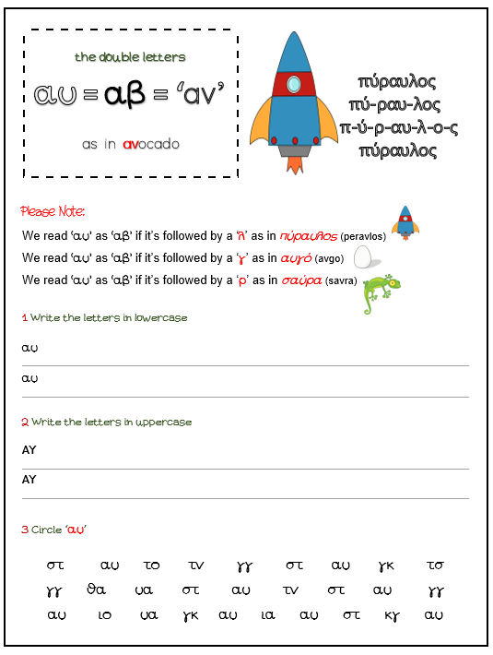

Slide 3
